Slide 1
The Cash Cows
Mathias Bohn, Rodrigo Garcia, Marlène Luce, Roman Zanoli HEC Paris
Paris, March 1, 2019

Slide 2


The Road Ahead
By
The Cash Cows

Slide 3
“If I had asked people what they wanted, they would have said faster horses…”
- Henry Ford

Slide 4


Table of contents
 | Executive Summary | p. 7
I. | Market Analysis | p. 9
II. | Strategic Fit General Motors Tesla Strategic Fit | p. 17
III. | Financial Analysis Comparables Discounted Cash Flow Synergies | p. 33
IV. | Feasibility | p. 51
V. | Alternative Solution | p. 56
VI. | Conclusion | p. 63
 | Appendix | p. 65
 | Bibliography | p. 95
Executive | Market |  | Strategic Fit |  | Financial |  | Feasibility |  | Alternative |  | Conclusion | | 4
Summary | Analysis |  |  |  | Analysis |  |  |  | Solution

Slide 5
Table of abbreviations
Abbreviation | Explanation
ADAS | Advanced Driver Assistance System
AV | Autonomous Vehicle
BEV | Battery Electric Vehicle
bn | Billion
CAGR | Compound Annual Growth Rate
DCF | Discounted Cash Flow
DOJ | Department Of Justice
EBIT | Earnings before Interest and Taxes
EBITDA | Earnings before Interest, Taxes, Depreciation, and Amortization
EV | Electric Vehicles
EV | Enterprise Value
FCF | Free Cash Flow
FTC | Federal Trade Commission
FY | Fiscal Year
GM | General Motors
HHI | Herfindahl-Hirschman Index
HQs | Headquarters
ICE | Internal Combustion Engine
IEA | International Energy Agency
IPO | Initial Public Offering
JV | Joint Venture
Abbreviation | Explanation
km | Kilometers
kWh | Kilowatt hour
lbs | Pounds
m | Million
M&A | Mergers & Acquisitions
mph | Miles Per Hour
NPV | Net Present Value
OEM | Original Equipment Manufacturer
OICA | International Organization of Motor Vehicle Manufacturers
OPEC | Organization of the Petroleum Exporting Countries
P/E | Price-to-Earnings ratio
PHEV | Plug-in Hybrid Vehicle
R&D | Research & Development
RMB | Renminbi
SEC | Securities and Exchange Commission
SEO | Secondary Equity Offering
SUV | Sport Utility Vehicle
USD | United States Dollars
WACC | Weighted Average Cost of Capital
YE | Year Ending
Executive | Market |  | Strategic Fit |  | Financial |  | Feasibility |  | Alternative |  | Conclusion | | 5
Summary | Analysis |  |  |  | Analysis |  |  |  | Solution

Slide 6
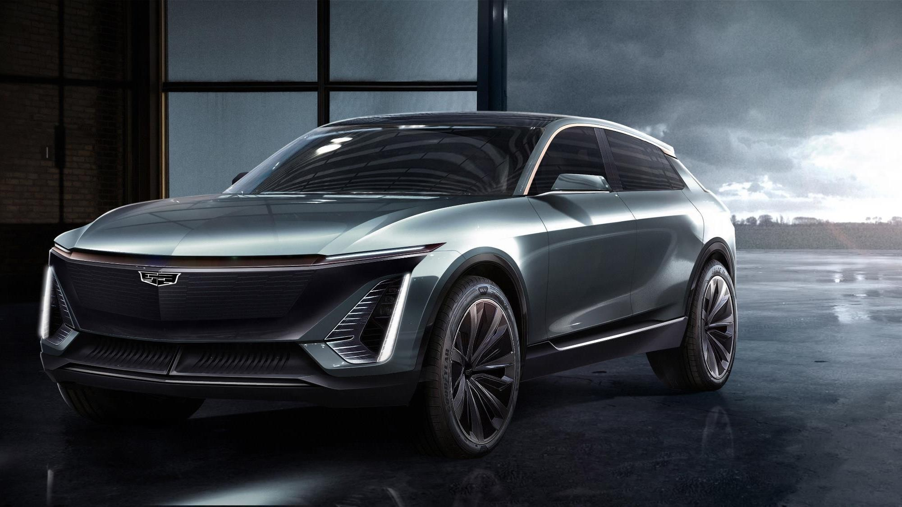
–
EXECUTIVE SUMMARY
The right choice for
General Motors

Slide 7

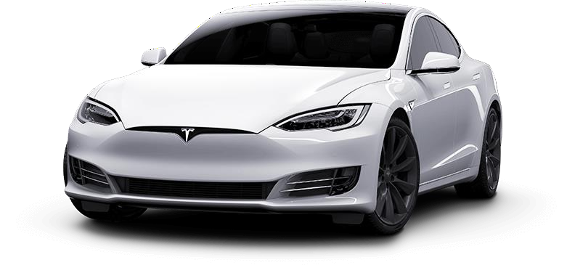
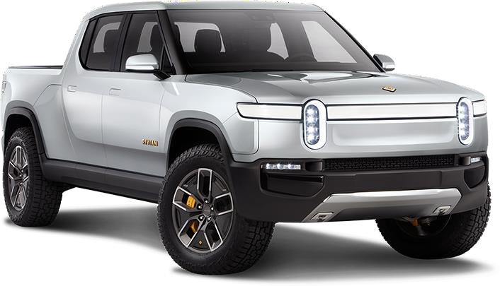
whose products and brand will have strategic value for GM in the future EV landscape
GM should not acquire Tesla, but instead acquire Rivian, an EV truck manufacturer
Should General Motors acquire Tesla?
GM should not acquire
The capital market currently overvalues Tesla by 18% Non-substantial synergies between GM and Tesla do not compensate for the high premium that needs to be paid, and an acquisition would, therefore, destroy USD 26.2bn in value An acquisition is not feasible from a financial perspective; a merger would make Elon Musk the major shareholder of the conglomerate; and Tesla has preventive measures in place
GM should acquire
Rivian’s brand and products, including an electric pickup truck, would be a perfect fit with GM’s core customers Rivian’s technologies, such as battery packs and self- driving tech, could be pushed by GM’s knowledge After analysing the potential price and shareholder’s structure, the acquisition is feasible for GM
Executive | Market |  | Strategic Fit |  | Financial |  | Feasibility |  | Alternative |  | Conclusion | | 7
Summary | Analysis |  |  |  | Analysis |  |  |  | Solution

Slide 8

I
MARKET ANALYSIS
The future of the
automotive industry

Slide 9
By 2030, more than 50 percent of the automotive industry’s revenue will be in disrupted
business areas, such as electric vehicles (EVs) and autonomous vehicles (AVs)
THE FUTURE OF THE AUTOMOTIVE INDUSTRY
More than 50 percent of the automotive industry’s revenue will be in disrupted business areas by 2030
Global automotive ecosystem revenues, in USD trillion, 2015-2030e
56% of 2030 revenues
7.7
Revenues from traditional business areas will drop by 38% due to disruption
will be coming from
disrupted opportunities
5.5
0.1
+4.3
4.3
-2.1
5.4
3.4
2015
Disrupted business areas, such as EVs, AVs and e-hailing
2030e
Traditional business areas, such as taxis and nonautonomous vehicles
Source: Dhawan, R., Hensley, R., Padhi, A. and Tschiesner, A. (2019, McKinsey Quarterly)
Executive | Market | Strategic Fit |  | Financial |  | Feasibility |  | Alternative |  | Conclusion | | 9
Summary | Analysis |  |  | Analysis |  |  |  | Solution

Slide 10
In the same year, 28% of all new car sales will be electric, but since forecasts have been
adjusted upwards every year in the past, this will most likely happen even sooner
ELECTRIFIED VEHICLE SALES
By 2030, more than every fourth car sold will be electric… … and this will likely happen sooner, considering past forecasts
Annual global light duty vehicle sales in million cars, 2015-2040e Bloomberg forecasts of new vehicle sales being electric, 2016-2018
120
110
100
90
80
70
60
50
40
30
20
10
0
100%
90%
80%
70%
55.0% 60%
50%
40%
30%
20%
10%
0%
105
108
110
Bloomberg is not alone – other global EV sales forecasts have been adjusted upwards every year by International Energy Agency and OPEC
+57%
100
90
54
55
50
+39%
62
43 43
75
+27%
35
Some analyst even say that ICE sales peaked in
43.0%
28
31
28.0%
22
24
2018 and that all future
53
+57%
growth will come from EVs
38
11.0%
24
8
11
7
2.3%
6 8 7
2015 2019e 2025e 2030e 2035e 2040e
EVs as % of new sales ICE* BEV* PHEV*
2025e
BNEF 2016 forecast
2030e 2035e
BNEF 2017 forecast
2040e
BNEF 2018 forecast
By 2040, 55% of all new car sales will be electric, and ~560 million EVs will be on the road, representing 33% of the global fleet
Forecasts have been revised upwards every year in the past couple of years, with the most change in the short and long term
Note: *: ICE: Internal Combustion Engine, BEV: Battery Electric Vehicles, PHEV: Plug-in Hybrid Electric Vehicles Source: Bloomberg (2017, 2018), MacDonald, J. (2016, Bloomberg), McGee, P. (2018, Financial Times)
Executive | Market | Strategic Fit |  | Financial |  | Feasibility |  | Alternative |  | Conclusion | | 10
Summary | Analysis |  |  | Analysis |  |  |  | Solution

Slide 11
Average purchase prices of EVs have been falling continuously and are now projected to
be on par with ICE vehicles around 2025, driven by a dramatic decline in battery cost
THE PRICE OF ELECTRIFIED VEHICLES
Purchase prices of EVs have been falling continuously… … driven by a dramatic decline in battery cost
Development in EV purchase price, in USD thousand, 2016-2030e
43.0
Lithium-ion battery costs, in USD per kWh, 2010-2030e
1,000
900
800
700
600
500
400
300
200
100
0
37.0
48%
29.5
30.0
39%
28.0
26.0
26%
18%
5%
8%
100 USD per kWh is generally referred to as the point where EVs become cost competitive with ICEs
9%
9%
47%
53%
66%
73%
2016
2019e 2025e
ICE Battery Powertrain Vehicle
2030e
2010
2015
McKinsey & Co
2020e
Bloomberg
2025e 2030e
The Economist
The average purchase price of EVs is projected to be on par with ICEs in 2025, driven by declining battery cost
Lithium-ion battery cost has decreased dramatically and is projected to reach USD 100 per kWh between 2022 and 2030
Source: : Bloomberg (2017, 2018), MacDonald, J. (2016, Bloomberg), McKinsey & Company (2017), The Economist (2017)
Executive | Market | Strategic Fit |  | Financial |  | Feasibility |  | Alternative |  | Conclusion | | 11
Summary | Analysis |  |  | Analysis |  |  |  | Solution

Slide 12
CHINA | In 2018, EV sales topped 1m for the first time, outstripping any other country,
despite overall vehicle sales shrinking, marking China’s projected global lead in EV sales
GENERAL MOTORS’ CORE MARKETS
In 2018, EV sales topped 1m in China for the first time… … and China will lead the charge as EV sales surge globally
Vehicle sales in China, in million of vehicles, 2014-2018 Annual global electric vehicle sales, in million cars, 2015-2030
25
24.38
24.96
23.80
15% 30
By 2025, China’s leaders want 7
29.8
21.21
million cars sold every year, or about 20 percent of the total, to be EVs, even higher than Bloomberg’s forecast
4.5
20
19.71
25
6.0
10%
20
The Chinese
+32%
15
government is currently offering large subsidies
24.04
24.38
22.78
15
7.8
10
19.63
21.00
and exemptions from
10.7
4.5%
5%
10
costly license plate fees
if consumers buy EVs
1.9
5
2.4%
2.4
1.0%
1.4%
5
11.5
0.4%
2.2
5.2
0
0.07
0.21
0.34
0.58
1.02
0%
0.4
2015 2016
China EVs
2017 2018
China EVs as % of new sales
0
2014
2015
2019e
2025e
2030e
China ICEs
Rest of World USA Europe China
In 2018, vehicle sales in China, the world’s largest car market, shrank for the first time since 1990, but EV sales kept on rising
China is not only the biggest global car market today but is also projected to be the world leader in electric vehicles going forward
Source: Bloomberg (2017, 2018), Hancock (2019, Financial Times), IEA (2019), InsideEVs (2019d), OICA (2019), MacDonald, J. (2016, Bloomberg), Zhang, Y., Naughton, K., Rauwald, C. and Sachgau, O. (2018, Bloomberg)
Executive | Market | Strategic Fit |  | Financial |  | Feasibility |  | Alternative |  | Conclusion | | 12
Summary | Analysis |  |  | Analysis |  |  |  | Solution

Slide 13
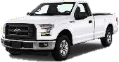
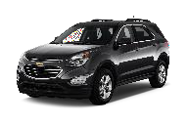
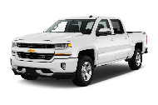
USA | In the US, EV sales are not climbing as fast as in China, partly due to a shift in
consumer preferences towards pickup trucks and SUVs, which have fewer EV options
GENERAL MOTORS’ CORE MARKETS
EV sales in the US has continued to climb in recent years… …, however, US consumers are more interested in large cars…
Vehicle sales in the US, in million of vehicles, 2014-2018 Vehicle sales in the US, in million of vehicles, 2014-2018
70% of the US market in 2018
+12%
+3%
20
10%
9%
8%
7%
6%
5%
4%
3%
2%
1%
0%
-9%
16.86
17.85
17.89
17.57
17.69
7.57
6.90
6.15
15
7.69
5.36
5.18
4.91
5.04
5.10
_{6.086.38}6.97
4.75
5.36
4.42
Sedans Pickup trucks
2014 2015 2016 2017 2018
SUVs
10
17.74
17.73
17.33
16.74
17.37
… due to a shift in preferences, which is profitable for car makers
5
2.1%
0.7%
0.6%
0.9%
1.2%
0
0.12
0.12
0.16
0.20
0.36
Shift in demand
Low fuel prices and a strong economy are incentivizing consumers to buy larger vehicles
Transaction prices
SUVs’ prices are 39% to 51% higher than sedans, but have minimal additional manufacturing cost
Luxury models
Consumers are increasingly willing to pay $70,000 to
$100,000 for modified pickup trucks
2014
2015
2016 2017 2018
USA EVs as % of new sales
USA ICEs USA EVs
Despite overall flat vehicle sales in the US, sales of electric vehicles has continued to climb, but not as much as in China
Source: Cohen, A. (2018, Forbes), Eisenstein, P. (2018, CNBC), Ferris, R. (2018, CNBC), General Motors (2016, 2019b), Irle, R. (2018, EVVolumes), Snyder, J. (2017, Automotive News)
Executive | Market | Strategic Fit |  | Financial |  | Feasibility |  | Alternative |  | Conclusion | | 13
Summary | Analysis |  |  | Analysis |  |  |  | Solution

Slide 14























USA | Major car manufacturers are, therefore, readying their product portfolios for a soon-
to-be-the-present future, in which their core customers want their favorite cars to be EVs
GENERAL MOTORS’ CORE MARKETS
Vehicles in the US
Percent of sales, 2018
CAGR 2014-2018
EV models in segment
Current models
EV models in segment
Announced models
Sedans
30.3%
-9%
Model S/3
Chevy Bolt
i3
Leaf
i-MiEV
ID
Mission E
Rapide E
Urban EV
Roadster
E-golf
Ioniq E
i8
Focus E
XJ
Taycan
Electric
SUVs
39.4%
+12%
Model X
Soul
e6
RAV4 EV
EQ
Q6 e-tron
X3
Model Y
XC90 T8
X5 Xdrive
I-PACE
Kona
XC40
BUDD-e
Niro
Pickup trucks
30.3%
+3%
Workhorse W-15*
Limited availability of EV models in the growing and highly profitable
F-150 electric Pickup truck
pickup truck segment represents a huge market opportunity
Note: *: The W-15 is not a pure BEV, but a plug-in range extended electric pickup (PHEV) designed for fleets. Workhorse have previously manufactured trucks for Fed Ex and U.S Postal Service; Source: General Motors (2016, 2019b), Companies website
Executive | Market | Strategic Fit |  | Financial |  | Feasibility |  | Alternative |  | Conclusion | | 14
Summary | Analysis |  |  | Analysis |  |  |  | Solution

Slide 15
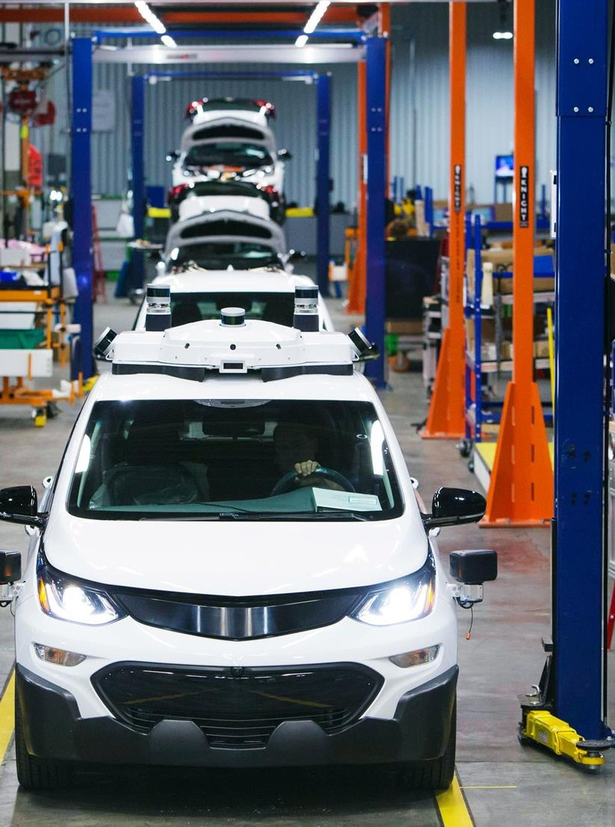
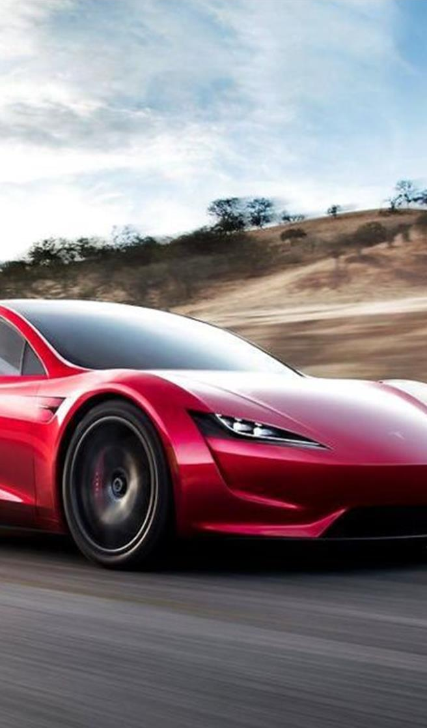

II
STRATEGIC FIT
1
GENERAL MOTORS
2
TESLA
3
STRATEGIC FIT
The state of GM
The state of Tesla
The fit between them

Slide 16

II
STRATEGIC FIT
1
GENERAL MOTORS
The state of GM
2 3
TESLA STRATEGIC FIT
The state of Tesla The fit between them

Slide 17




















General Motors is one of the largest car manufacturers in the world with a clear vision for
the future and holds market leading positions in the US and China
GENERAL MOTORS OVERVIEW
GM is one of the largest car manufacturers in the world… … and is selling most of its cars in the US and China
Revenues of automotive manufacturers, in USD billion, FY2018* GM’s vehicle sales, in number of vehicles, 2018
USA
3.0m vehicles sold
Europe
0m vehicles sold
0% 100%
China
3.6m vehicles sold
GM has a vision of Zero Crashes, Zero Emissions, and Zero Congestion
276
270
17%
83%
14%
86%
192
0
160
3.0m
Sold through local Joint Ventures
147
145
134
132
3.6m
118
112
1.3m
0.6m
Brand portfolio
Other Americas
1.3m vehicles sold
Rest of World
0.6m vehicles sold
3% 98%
GM’s market share Other players’ market share
15%
85%
No. vehicles sold
Note: *: FY 2018 or most recent publicly available filing
Source: Thomson Reuters Eikon (2019), General Motors (2019b)
Executive
Summary
Market Strategic Fit
Analysis
Financial
Analysis
Feasibility
Alternative
Solution
Conclusion
| 17

Slide 18
GM has been showing stable performance, which is largely due to its great performance
with its core customers, the truck segment, of which it has a 25% share of the US market
GENERAL MOTORS’ PERFORMANCE IN THE MARKET
GM has been showing stable performance in the past years… In the US, GM is doing very well within pickup trucks and SUVs…
GM’s revenues and operating margin, in billion USD, 2014-2018 GM’s vehicle sales in the US, in million of vehicles, 2014-2018
200
150
100
50
0
10
8
6
4
2
0%
CAGR 2014 – 2018
Sedans: -12.4%
3.1 3.0
3.0
155.9
152.4
149.2 145.6 147.0
2.9 3.0
1.1
0.9
0.9
0.7 0.6
5.8%
5.9%
1.3
1.4
Trucks:
SUVs:
4.1%
7.0%
3.0%
1.1
1.3
1.3
1.0%
3.2%
1.0
0.7 |  | 0.9 |  | 0.8 |  | 1.0
2014 |  | 2015 |  | 2016 |  | 2017
2014
2015 2016 2017 2018
Operating income
2018
Revenue
Sedans Pickup trucks SUVs
… and is dominating the competition when it comes to trucks
… while exiting the European market completely in 2017
GM’s vehicle sales, in million of vehicles, 2014-2018
Market share in vehicle sales in the US, 2018
GM Others
16.7%
9.9 10.0 10.0
9.6
3.4
3.6
3.6
3.6
8.4
10.4%
25.4%
14.8%
NA*
3.5
Asia** SA*** Europe
4.4
4.5
4.6
4.7
4.2
89.6%
74.6%
85.2%
83.3%
For five consecutive years, GM has sold more
1.3
1.2
1.2
0.7
0.7
pickup trucks in the US than any other manufacturer
2014 2015 2016 2017
Note: *: North America; **: Asia/Pacific, Middle East, Africa; ***: South America Source: General Motors (2019b)
2018
Sedans
Pickup trucks SUVs Total
Executive
Summary
Market Strategic Fit
Analysis
Financial
Analysis
Feasibility
Alternative
Solution
Conclusion
| 18

Slide 19

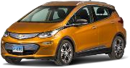
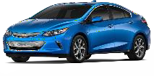
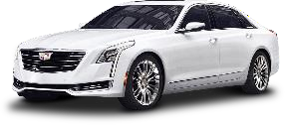
GENERAL MOTORS’ RESPONSES TO THE AV AND EV TREND
GM has taken a leading position within autonomous vehicles and had the second largest
share of EVs sold in the US last year, having also announced multiple new EV initiatives
GENERAL MOTORS’ AV RESPONSE
GM has made headway in the AV market by acquiring Cruise…
Founded in 2013 and acquired by General
Motors in 2016
GENERAL MOTORS’ EV RESPONSE
GM holds the second largest EV share, driven by two models…
Share of EVs sold in the US, 2018
Others GM Tesla
37%
Estimated value* •
$14.6bn
Deeply resourced, with more than 1,100 employees and 180 vehicles registered
10%
The Chevrolet Volt
Launched in 2010, the plug-in hybrid has only seen limited success
The Chevrolet Bolt
Launched in 2016, it was the
only 238-mile range BEV for
$37,495, until the Hyundai
Kona EV launched this year
$5 billion in external capital raised in 2018
53%
$1.0bn
Planning to commercialize at scale in 2019
2016 2018
… and is now the clear number two in miles driven after Waymo
Miles driven per disengagement*, December 2017 - November 2018
11,154
In the end of 2018, GM sold its 200,000th electric vehicle
2018
in the US – the second car manufacturer to do so after Tesla
… and has announced multiple new EV initiatives going forward
GM Cruise reported the second- lowest disengagement rate**,
?
The Cadillac will use GM’s “BEV3” next-gen
electric vehicle platform, ready by 2021
GM plans to introduce 20 electric vehicles globally by 2023 in the US and China
GM aims to sell 1 million electric vehicles a year by 2026, many of them in China
5,204
321% better than a year ago
1,922
The Cadillac EV
Cadillac will become the leading electric vehicle brand of GM
1,028
1,022
210
206
Waymo GM Cruise Zoox Nuro Pony.AI Nissan Baidu
Source: CA.GOV (2019), InsideEVs (2019c), Seeking Alpha (2018a), General Motors (2019a), Bloomberg (2019)
Note: *: Values estimated based on investments of GM in ‘16 and Honda/Softbank in ‘18; **: A disengagement means "deactivation of the autonomous mode when a failure of the autonomous technology is detected or when the safe operation of the vehicle requires that the autonomous vehicle test driver disengage the autonomous mode and take immediate manual control of the vehicle."
Executive
Summary
Market Strategic Fit
Analysis
Financial Feasibility
Analysis
Alternative Conclusion
Solution
| 19

Slide 20




GM is also greatly positioned for growth as a share leader in the world’s largest markets
and is strong within capacity and supply chain management as well as product design
GENERAL MOTORS’ STRENGTHS AND CAPABILITIES
GM is currently a market share leader in the US and China… GM also shows great strengths within product design…
GM ranking in terms of country market share, 2018 Research and development expenditures, in billion USD, 2016-2018
Greatly positioned for growth in the largest car markets in the world
Largest foreign automaker in China and maintains numerous very successful joint ventures
+11%
+7%
High R&D spending in
autonomous and electric vehicles
R&D spending show positive correlation with revenues and customer satisfaction
#1
USA
#2
China
7.8
6.6
7.3
2016 2017 2018
… as well as favorable and improving supplier relations
… with great production capabilities and capacity management
Difference production and sales in China, in thousands of cars, 2018
OEM Supplier Relation Index*, 2015-2018
Dongfeng HONDA
SAIC Volkswagen BMW Brilliance Automotive
Beijing Benz Automotive
55
350
-0.9%
22
-5.2%
+28.1%
-4.2%
300
12
7
In the same period of 2018, GM
250
SAIC GM
1
managed to sell more than 3.64 million cars in China
-8.9%
-25.4%
200
0
2015 2016
FAW-Volkswagen
-5
-5 0 5 10 15 20 25 30 35 40 45 50 55
2017
2018
Note: *: A score above 250 is considered as adequate, and a score above 350 is considered as good to very good
Source: Statista (2019b, p. 22), MarketLine (2018, p. 57), Hancock (2019, Financial Times), General motors (2019b), Henke (2017, Planning Perspectives Inc.)
Executive
Summary
Market Strategic Fit
Analysis
Financial Feasibility
Analysis
Alternative
Solution
Conclusion
| 20

Slide 21
However, none of GM’s brands are among the top in the US, and GM is highly dependent
on pickup trucks and SUVs with high emissions for which they do not offer an EV solution
GENERAL MOTORS’ KEY CHALLENGES
None of GM’s brands are among the top ten carmaker brands… GM is also highly dependent on vehicles with large emissions…
Most valuable global brands for carmakers, in billion USD, 2018 Global warming emissions scores by major automakers, 2018
30.0 116
Tesla’s brand increased 60% 112
in value from 2017 to 2018
#1
25.7 25.6
98
108
#2
#3
83
89
90
95
12.7 12.7
11.4
9.6 9.4
In 2018, GM’s cars had the second largest environmental impact of the 8 largest automakers, which is especially pronounced in their pickup truck and SUV segments
#4
#5
#6
#7
#8
6.4
6.0
#9
#10
34
Toyota MB* BMW Ford Honda Nissan Audi Tesla MS** VW
… even though GM is the carmaker that spends the most on ads
Advertising spending in the US, in million USD, 2017
Tesla Honda HK*** Nissan VW Toyota Ford GM FC****
… and GM does not currently have an EV for its core customers
General Motors Co. |  | 3,244
Ford Motor Co. Fiat Chrysler Automobiles Toyota Motor Corp. Honda Motor Co. Nissan Motor Co. Volkswagen Kia Motors Corp. Hyundai Motor Co. Subaru Corp. | 2,454 1,975 1,780 1,331 1,087 ₇₄₆ In 2019, The Chevrolet ₆₆₀ Volt will be discontinued, to enable more focus on ⁵⁸⁸ BEVs for GM 431
# of EVs sold, 2016-2018
-26% -23%
2016 2017 2018
GM’s CEO Mary Barra has not announced any plans that GM is building an all-electric pickup truck
24,739 _{20,349}
23,297
18,306
18,019
In 2019, Mary Barra also said that GM does not expect to turn a profit on EVs until "early next decade”
GM expects higher year-over-year sales for the Bolt in major markets in 2019
579
Chevrolet
Volt PHEV
Chevrolet
Bolt BEV
Note: *: Mercedes-Benz; **: Maruti Suzuki; ***: Hyundai-Kia; ****: Fiat Chrysler
Source: Cooke, D. (2018, Union of Concerned Scientists), MarketLine (2018), GM Authority (2019a, 2019b), General Motors (2019c), Irle, R. (2018, EVVolumes), Statista (2019b), InsideEVs (2019c), Kantar Millward Brown (2018) , Ferris, R. (2019, CNBC)
Executive
Summary
Market Strategic Fit
Analysis
Financial Feasibility
Analysis
Alternative Conclusion
Solution
| 21

Slide 22
II
STRATEGIC FIT
2
TESLA
The state of Tesla
1 3
GENERAL MOTORS STRATEGIC FIT
The state of GM The fit between them

Slide 23

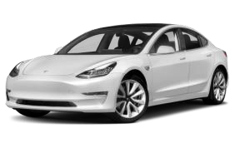
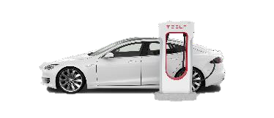
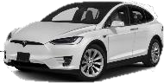
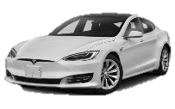
Tesla was an early pioneer in the EV market, but “production hell” challenged its vision of
launching a mass market vehicle with a $35,000 price tag until the second half of 2018
TESLA OVERVIEW AND HISTORY
Tesla was an early pioneer in the EV market and BEV segment
Founded in 2003 and joined by current CEO Elon Musk in 2004
Tesla’s “production hell” challenged its scale-up until Q3-2018
Number of Tesla vehicles delivered worldwide, Q3-2015-Q4-2018
100,000
90,000
80,000
70,000
60,000
50,000
40,000
30,000
20,000
10,000
0
 | Tesla Tesla delivers delivers its first its first Model X Model 3 During 2018, Tesla delivered 245,240 electric vehicles, up 138% year-over-year | Tesla meets its production goal of 5,000 cars in a week
+6,338%
Popularized EVs in 2008 with its launch of
the world’s first luxury EV, the Tesla Roadster
IPO-ed in 2010 and has since then grown
from 650 to 41,850 employees
In 2017, Tesla launched the Model 3 with the vision of it becoming Tesla’s mass market vehicle with a $35,000 price tag
41,850
650
Employees at IPO, 2010
Employees today, 2019
Tesla sells three EVs and offers an extensive charging network
Q3- Q4- Q1- Q2- Q3- Q4- Q1- Q2- Q3- Q4- Q1- Q2- Q3- Q4- 2015 2015 2016 2016 2016 2016 2017 2017 2017 2017 2018 2018 2018 2018
Tesla’s current lineup
Tesla Model S: A luxury liftback
Tesla Model X: A luxury SUV
Tesla Model 3: A luxury sedan
Tesla’s charging network
~13,000 Superchargers globally
Aims to cover 95% to 100% of the
population in all active markets
In 2017, CEO Elon Musk predicted that Model 3 production would be up to 5,000 units per week by December, however, Tesla did not manage to reach this target before July 2018
Source: Gibbs (2018, Guardian), Randall, T. and Halford, D. (2019, Bloomberg), Statista (2019d), Tesla Inc. (2016, 2017, 2018, 2019a, 2019b), Vlasic (2017, New York Times)
Executive
Summary
Market Strategic Fit
Analysis
Financial Feasibility
Analysis
Alternative Conclusion
Solution
| 23

Slide 24
After managing to ramp up production, Tesla is not only dominating the BEV segment, but
is also threatening conventional carmakers, and sales are expected to grow more in 2019
TESLA’S PERFORMANCE IN THE MARKET
Tesla is not only dominating the BEV segment…
Tesla’s BEV sales in the US, in thousand of vehicles, 2017-2018
… but also the luxury car segment in the US…
Premium vehicles sold in the US, in thousand of vehicles, 2018
In the second half of 2018, ~70%
139.8 #1 | Tesla’s Model 3 was also the best-selling passenger car in terms of revenue in the 111.6 US in both Q3 and Q4 in 2018 ^{76.0} 70.0 69.7 _{65.7 63.6 62.1 60.6} #2 ^{#3} #4 #5 #6 _{#7 #8 #9}
Tesla | Lexus | BMW | Audi Mercedes- BMW | Acura | Lexus | Cadillac
Model 3 | RX | 3/4 | Q5 Benz GLC X3/X4 | RDX | NX | XT5
of Model 3 customers made a
purchase without a test drive
91.2
80.6
+22%
61.7
54.3
37.4
30.4
30.5
29.7
15.7
5.0
22.6
23.2
6.3
6.0
8.2
8.5
… and sales are expected to grow further in 2019
Number of Tesla vehicles delivered globally, 2018-2019e
4.3
4.6
5.1
8.4
7.4
4.5
8.1
6.1
5.3
5.5
7.6
7.4
12.2
13.4
15.4 15.5
11.7 11.2 10.7
13.7
+63%
CEO Elon Musk predicts that Tesla will deliver 360,000 to 400,000 vehicles in 2019, driven by higher sales of the Model 3
In addition, Tesla expects to ramp up Model
3 deliveries and sales in Europe and China
Q1-2017 Q2-2017 Q3-2017 Q4-2017 Q1-2018 Q2-2018 Q3-2018 Q4-2018
Tesla Model 3 Tesla Model X Tesla Model S Other BEVs
400,000
245,000
Since it started with volume production in 2018, Tesla has been the largest single contributor to EV growth in the US
2018 2019e
Note: *: Tesla sold 140,000 Model 3s in 2018. Pre-orders were around 455,000 after cancellations and confirmed by Tesla to be well over 400,000 in 2018. Tesla will have pre-orders for about 300,000 Model 3s globally to fulfill in 2019.
Source: InsideEVs (2019c), Car and Driver (2019), CarSalesBase (2019)
Executive
Summary
Market Strategic Fit
Analysis
Financial Feasibility
Analysis
Alternative Conclusion
Solution
| 24

Slide 25


Due to the success of Model 3, Tesla has seen extraordinary growth, and the BEV maker
even managed to turn a profit in Q3 and Q4 of 2018, on-par with other car manufacturers
TESLA’S FINANCIAL PERFORMANCE
Tesla’s revenues have been increasing exponentially…
Tesla's revenues, in billion USD, 2008-2018
… and in Q3 and Q4 of 2018, Tesla also managed to turn a profit
Operating margins of carmakers, in %, 2017-2018
22
20
18
16
14
12
10
8
6
4
2
0
21.46
15
Year of Tesla’s IPO
10%
5%
+107%
0%
11.76 17.63
-5%
7.00
-10%
4.05
-15%
3.20
1.56
2.01
-20%
0.01 0.11 0.12 0.20 ^{0.41}
2008 2009 2010 2011 2012 2013 2014 2015 2016 2017 2018
Total revenue Automotive Energy Services Leasing
1.39
Q1-2017 Q2-2017 Q3-2017 Q4-2017 Q1-2018 Q2-2018 Q3-2018 Q4-2018
Tesla BMW Daimler Jaguar (Tata) Toyota GM
The success of Model 3 carried over to Tesla’s financial performance in Q3 and Q4 of 2018, changing its operating margin from being negative to on-par with other carmakers
In 2018, more than 82% of Tesla’s revenues came from its automotive segment (not including leasing)
Source: Tesla Inc. (2016, 2017, 2018, 2019a, 2019b), Thomson Reuters Eikon (2019), Statista (2019e)
Executive
Summary
Market Strategic Fit
Analysis
Financial
Analysis
Feasibility
Alternative
Solution
Conclusion
| 25

Slide 26



Tesla’s success is based on its strong brand and consumer satisfaction as well as its
ability to produce technologically dominant cars that beat every other BEV on the market
TESLA’S STRENGTHS AND CAPABILITIES
Selling more BEVs does not just fill demand for Tesla…
Tesla’s vehicles are technically dominant in the BEV segment…
All-electric range in miles for BEVs in the US, 2018-2019
Tesla Model S 100D Tesla Model 3 LR* Tesla Model X 100D
335
310
#1 in customer satisfaction of all car brands, according to Consumer Reports
4 in 5 Tesla customers buy or lease another Tesla when they return to market, according to Experian
295
Hyundai Kona Electric
Chevrolet Bolt Nissan LEAF Volkswagen e-Golf
258
… it creates demand, reflected in Tesla’s ad spending per car
238
Advertising spending per vehicle sold in the US, in USD, 2017
150
Tesla | 0
Fiat orsche Honda Dodge Jaguar wagen enesis Lincoln Romeo | 40
125
124
Tesla’s range and price per mile dominance is due to its superior battery technology
Without spending any money on ads, Tesla received more than 325,000 reservations in less than a week after the announcement of Model 3
Hyundai IONIQ Electric
P
161
… And the Tesla’s Model 3 LR* is competitive on price as well
260
267
BEVs price per mile of range in USD, 2018-2019
1,207
1,221
Chevrolet Bolt | 158
Tesla Model 3 LR* | 162
Nissan LEAF yundai IONIQ Electric Volkswagen e-Golf
Volks
G
1,590
204
2,511
H
245
Alfa 8,577
Note: *: Tesla Model 3 Long Range
Source: Bartlett (2019, Consumer Reports), InsideEVs (2019a), Smith (2018, Experian), Statista (2019b)
251
Executive
Summary
Market Strategic Fit
Analysis
Financial
Analysis
Feasibility
Alternative
Solution
Conclusion
| 26

Slide 27

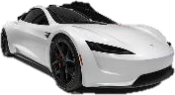















TESLA’S FUTURE AND CHALLENGES
In 2019, Tesla will unveil its pickup truck and begin production of the Model 3 in China,
but is still experiencing financial troubles, while competition is coming in fast
In 2019, Tesla will unveil its pickup truck and the Model Y…
Cars models that have already been announced by Tesla
However, Tesla is still burning cash and piling up debt…
Free cash flow and long-term debt, in million USD, 2014-2018
? ?
Tesla Pickup Truck
10,000
5,000
0
-5,000
9,418 9,404
5,978
1,877
2,068
Tesla Model Y
An all-electric SUV, cheaper than Model x
Will be unveiled in the first half of 2019
Tesla Roadster
A new version of Tesla’s first-ever electric sports car
Will launch in 2020
-240
An all-electric pickup truck
Will be unveiled during 2019
-1,048
-2,198
-1,540
-4,257
2017
2014 2015
Free Cash Flow*
2016
Long-term debt
2018
… as well as begin production in China by the end of the year
… and new competitors are entering Tesla’s segments fast
New BEVs being launched in 2019
Luxury Mass market
+100%
Chinese Gigafactory will enable Tesla to bypass tariffs and will qualify Tesla’s cars for a $10,000 subsidy from the government
Tesla plans to be able to begin production of the Model 3 in China by the end of 2019
The factory will eventually produce 500,000 cars a year, doubling Tesla's projected output
1,000,000
500,000
**
**
Planned output in the US
Future global manufacturing capacity
Q1-2019 Q2-2019 Q3-2019 Q4-2019
Note: *: Free cash flow figures are accounting numbers; **: BMW and Nissan are not launching new EVs, but the i3 and LEAF models are getting significant enough updates to be mentioned here Source: Lambert, F. (2018d, Electrek), Tesla Inc. (2016, 2017, 2018, 2019), Zhang, Y. and Hull, D. (2019, Bloomberg), Companies annual report
Executive
Summary
Market Strategic Fit
Analysis
Financial Feasibility
Analysis
Alternative Conclusion
Solution
| 27

Slide 28
II
STRATEGIC FIT
1 2
GENERAL MOTORS TESLA
The state of GM The state of Tesla
3
STRATEGIC FIT
The fit between them

Slide 29












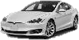




The strategic fit between GM and Tesla is especially promising when it comes to
leveraging GM’s production expertise in helping Tesla scale
THE STRATEGIC FIT BETWEEN GM AND TESLA
Research and development Production and sales Products and brands
Self-driving tech for AVs
Production capacity and expertise
GM is closing down “one-shift sedan plants”, which Tesla could take over, and GM could also offer expertise Tesla is ramping up production and is aiming to double capacity in China in the coming years GM can support Tesla in scaling production and building more factories
Sales networks
Product portfolio
GM Cruise’s self-driving tech is industry leading, whereas Tesla’s Autopilot is more uncertain
GM has announced next-gen electric vehicle platform, which will underly 20 all-electric models
?
The technologies are also different, and Tesla’s cars cannot use GM’s tech due to a lack of Lidar*
GM’s tech could potentially be used in future Tesla cars, but not right now
?
However, Tesla has announced an all-electric pickup truck, which GM’s platform does not support
Tesla’s coming pickup truck has a lot of potential among GM’s core customers
Batteries for EVs
Brand portfolio
GM has plenty of experience and initiatives within battery making
GM’s has extensive sales networks
in both the US and China
None of GM’s brands are as strong as Tesla’s brand is, especially within the EV segment
However, Tesla’s battery tech is industry leading and could be used in GM’s cars as well
However, instead of dealerships, Tesla uses direct sales, showrooms and service centers
However, GM already has plans to make Cadillac its lead EV brand
Tesla’s battery advantage could be shared with GM and increased through scale
Tesla’s approach to selling is so different from GM’s that the potential is limited
Tesla’s brand is still stronger and could be used to increase the sales of GM’s EVs
Note: *: Lidar is a surveying method that is used in control and navigation for some autonomous cars, including those of GM Cruise Source: Team analysis, Goldman (2018, CNN Business), Welch (2018b, Bloomberg), Wayland (2018, Automotive News)
Deep dive on following slide
Strategic fit No strategic fit
Executive
Summary
Market Strategic Fit
Analysis
Financial Feasibility
Analysis
Alternative
Solution
Conclusion
| 29

Slide 30
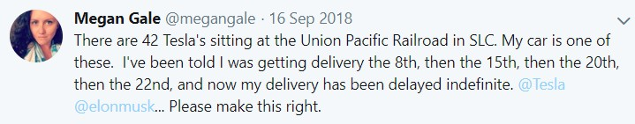
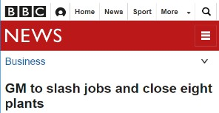
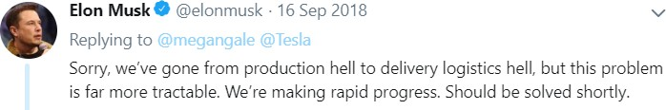
The most promising area for a fit addresses the current supply/demand gap by leveraging
GM’s mass production and delivery expertise, financial resources and empty factories
PRODUCTION CAPACITY AND EXPERTISE
Tesla has a track record of not being able to meet the demand…
Expertise
Tesla Model 3 US deposits, in % of Apr 18, April 2017 – April 2018
This development will continue, as China is allowed to pre-order
Tesla and GM could combine innovation with
mass, as Tesla could eventually lack the | 2018 | 8.380.000
expertise to scale their production
GM is currently producing >30x Tesla’s | 245.322
units, so they have the expertise | Tesla | GM
Hold reservation Refunded Purchased 100%
80%
60%
40%
20%
0%
Financial resources
Tesla needs high levels of CAPEX, e.g. in order to meet Model Y production targets
However, last year, their CAPEX/sales ratio declined dramatically
Tesla needs a capital injection
CAPEX/Sales
32%
Apr- 17
Jan- 18
Apr- 18
… and has been going through “logistics hell”
11%
2017 2018
Empty factories
Tesla’s main California factory is a former Toyota-GM combined assembly line
Tesla could utilize the factories GM will close in 2019, as it grows
Source: Barnard (2018, CleanTechnica), Gessner (2018, Second Measure), Seeking Alpha (2018b), Musk, E. (2018, Twitter)
Executive
Summary
Market Strategic Fit
Analysis
Financial Feasibility
Analysis
Alternative
Solution
Conclusion
| 30

Slide 31
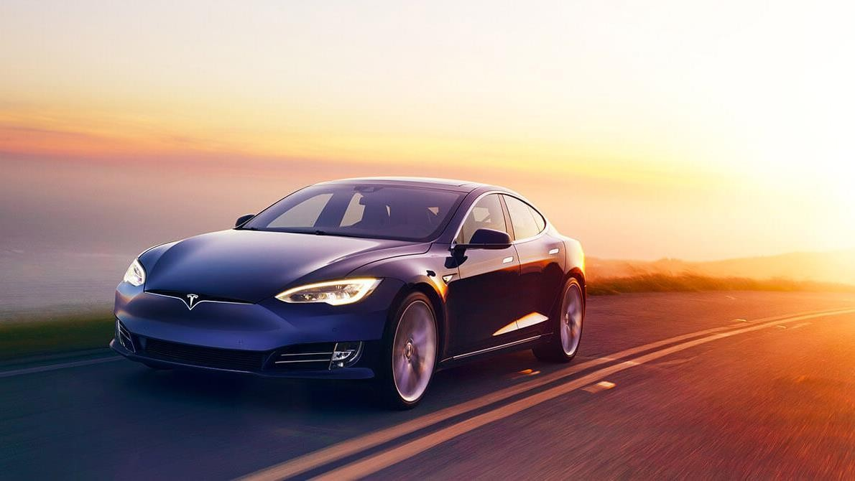
III
FINANCIAL ANALYSIS
1
COMPARABLES
2
DISCOUNTED CASH FLOW
3
SYNERGIES
Trading and transaction multiples
Business case forecasting and DCF
Assessment of potential synergies

Slide 32
III
FINANCIAL ANALYSIS
1
COMPARABLES
Trading and transaction multiples
2 3
DISCOUNTED CASH FLOW SYNERGIES
Business case Assessment of forecasting and DCF potential synergies

Slide 33
METHODOLOGY OF FINANCIAL ANALYSIS
To assess the financial attractiveness of Tesla, we derive its fair value based on multiple
and DCF analyses, estimate synergies and compare them to the purchasing price
GM’s shareholder value Tesla’s shareholder value
Standalone enterprise value derivation
Purchasing price
Comparable analysis
Discounted cash flow
Trading
multiples
Transaction
multiples
Current market valuation
Premium
+
Synergies
Source: Own analysis and illustration
Executive |  | Market |  | Strategic Fit | Financial | Feasibility |  | Alternative |  | Conclusion | | 33
Summary |  | Analysis |  |  | Analysis |  |  | Solution

Slide 34




















We identified traditional automakers, pure EV producers, renewable energy firms and AV
tech companies as potential peer groups for Tesla for comparable analysis
POTENTIAL PEER GROUP
Traditional automotive manufacturing
Logic: Tesla competes in automotive sales with traditional OEMs, from which the following have the biggest EV presence
Prospective pure EV manufacturing
Logic: Similar business model in 2025, but different revenue growth
No publicly available data
Renewable energies
Logic: Following the acquisition of Tesla of Solarcity, that is active in the production of solar energy and solar cells
Tech-companies involved in autonomous driving
Logic: Tesla’s “Autopilot” could be be a major revenue driver in the future
Source: Thomson Reuters Eikon (2019), General Motors (2019b), NVIDIA (2019), Stockreports+ (2019), Brinkman (2019, Thomson Reuters), Jonas (2019, Thomson Reuters), Houchois (2019,
Thomson Reuters)
Executive |  | Market |  | Strategic Fit | Financial | Feasibility |  | Alternative |  | Conclusion | | 34
Summary |  | Analysis |  |  | Analysis |  |  | Solution

Slide 35




Based on an analysis that assesses the CAGR, brand relevance, as well as revenue and
cost drivers, pure EV producers are the only peer group that can be retained
SELECTION OF PEER GROUP
Market size (‘18)
CAGR* (‘18-’25)
Brand relevance
Industry wide analysis
Biggest revenue drivers
Biggest cost driver Retained
EV vehicle sales
Batteries
Services
Charging stations
Other
Batteries for production
Direct labour
R&D
Other
Tesla
-
15%
-
EV vehicle sales
Batteries
Services
Charging stations
Other
Batteries for production
Direct labour
R&D
Other
Automotive manufacturing
USD 3.4tn
3%
Prospective pure EV manufacturing
EV vehicle sales
Batteries
Services
Charging stations
Other
Batteries for production
Direct labour
R&D
Other
USD 0.2tn
22%
Renewable energies
EV vehicle sales
Batteries
Services
Charging stations
Other
Batteries for production
Direct labour
R&D
Other
USD 0.7tn
5%
Autonomous driving
EV vehicle sales
Batteries
Services
Charging stations
Other
Batteries for production
Direct labour
R&D
Other
USD 0.02tn
19%
Note: *: CAGR of market size
Yes
No
Source: Xerfi (2018), Grand View Research (2018), Businesswise (2019), Euromonitor (2016), BCG (2018a), UCSUSA (2017), NVIDIA (2019), Allied Market Research (2017)
Executive |  | Market |  | Strategic Fit | Financial | Feasibility |  | Alternative |  | Conclusion | | 35
Summary |  | Analysis |  |  | Analysis |  |  | Solution

Slide 36








We identified five prospective pure EV manufacturing peers which are projected to be at
least 60% electric by 2025 and show similar margins as Tesla
FINANCIAL ANALYSIS OF PEERS
2017: China announces ban for fossil fuel vehicles by 2040
EV
share 2018*
EV
share 2025e*
EBITDA margin 2019e
EBIT margin 2019e
Net income margin 2019e
Short description and rationale
Automotive and energy company based in Palo Alto
Specialized in EV manufacturing
100%
100%
11%
2%
1%
One of the top 4 automakers in the country
34 new energy models by 2025
Median: 13%
Median: 5%
Median: 3%
6%
100%
5%
5%
4%
BYD Auto is an OEMs which is the 2nd largest global plug-in car manufacturer
Prospective pure EV manufacturing
100%
100%
12%
5%
3%
Holding automotive company
Company with highest EV market share in China (7%)
5%
100%
17%
14%
3%
Automotive company, owner of Volvo since 2010 (100% electric by 2019)
6%
60%
16%
15%
12%
Manufacturer of electric cars, specialized in the production and sale of SUVs
100%
100%
13%
3%
1%
Note: *: EV share representing the share of sales in the respective years that relates to electric vehicles Source: Hevi (2017), BYD (2018, pp. 1-2), Volvo (2018), Geely (2018)
Executive |  | Market |  | Strategic Fit | Financial | Feasibility |  | Alternative |  | Conclusion | | 36
Summary |  | Analysis |  |  | Analysis |  |  | Solution

Slide 37




Based on financial peer group multiples, Tesla appears to be highly overvalued; however,
innovation multiples are more in line with market expectations
TRADING MULTIPLES
Financial multiples
Innovation multiples
Overvalued
Good proxy for value based on innovation efforts
EV*/Sales 2019e** EV*/EBITDA 2019e** EV*/EBIT 2019e**
2,3 20,5 112,6
EV*/Patents in electric vehicles
EV*/Engineering FTEs focused on EV
232,4
9,2
Median: 1.3x
Median: 10.8x
Median: 23.2x
Median: 215.3x
Median: 14.0x
0,4x
14,1x
30,8x
722,4x
5,7x
Prospective pure EV
1,3x
10,7x
23,2x
41,3x
14,0x
manufacturing
0,5x
2,7x
3,4x
215,3x
60,0x
1,7x
10,8x
12,0x
1.889,0x
30,7x
2,1x 16,3x 76,6x 20,7x
Note: *: EV aligned with the whole financial analysis as of 22nd of February, 2019; **: Applied multiples based on forecasts due to the growth profile of Tesla Source: Bloomberg (2019), Thomson Reuters Eikon (2019), Justia (2019), BAIC (2018)
1,0x
Executive |  | Market |  | Strategic Fit | Financial | Feasibility |  | Alternative |  | Conclusion | | 37
Summary |  | Analysis |  |  | Analysis |  |  | Solution

Slide 38


Nevertheless, this peer group should have a lower weight in the final valuation than the
DCF, as Tesla’s growth profile is very differentiated
VALIDATION OF TRADING MULTIPLES
EV / Sales 2019e vs. Sales CAGR 2017a-2019e Key observations
2,8
2,6
2,4
2,2
2,0
1,8
1,6
1,4
1,2
1,0
0,8
0,6
0,4
0,2
0,0
Peers have significantly different growth profiles compared to Tesla
Based on the sales CAGR of its peers, Tesla would have a valuation 11% higher than what the market currently expects based on the regression analysis
There are big gaps between the profiles of the different peers in the sample
EV / Sales 2019e based on regression = 2.7x
Based on market = 2.3x
EV / Sales 2019e
y = 3.6583x + 0.5866
R² = 0.5828
-2 0 2 4 6 8 10 12 14 16 18 20 22 24 26 28 30 32 34 36 38 40 42 44 46 48 50 52 54 56 58
Multiples-based valuation should have a smaller weight than the DCF in assessing Tesla’s value
Sales CAGR 2017a-2019e
Same analysis based on EBITDA financials not applicable because of decreasing profitability of some of its peers
Source: Bloomberg (2019), Thomson Reuters (2019)
Executive |  | Market |  | Strategic Fit | Financial | Feasibility |  | Alternative |  | Conclusion | | 38
Summary |  | Analysis |  |  | Analysis |  |  | Solution

Slide 39
































Through selected transaction multiples in the four industries, we estimate an EV / Sales
multiple for Tesla of 1.2x, but we decrease its weight as an estimate for Tesla’s valuation
TRANSACTION MULTIPLES
Transaction multiples
Conclusion
EV/Sales
The transaction multiples of the automotive, renewables and AS industries are not good proxies to estimate the value of Tesla if acquired by GM
As underlined before, the targets in these industries differ substantially, especially in size
The premium of each of the deals varies widely to the synergies that GM and Tesla could have
Therefore, we will only compute the median of the EV peers, but with a lower weight as the DCF
acquires
Automotive
4,5
EV
4,0
Renewables AS
3,5
3,0
acquires
acquires
Deal size
2,5
2,0
1,5
1,0
0,5
0,0
acquires
acquires
acquires
acquires
Median
EV/Sales: 1.2
acquires
acquires
Date
01/01/07 01/01/08 01/01/09 01/01/16 01/01/17 01/01/18 01/01/19
The EV / EBITDA multiple is only available in 3/10 deals
due to lack of data availability and negative profitability of the targets
Note: When not available in USD, the Sales and EV were converted to USD using the annual average exchange rate. *Sales multiple for Argo AI is a Bloomberg estimate. Source: MergerMarkets (2019), Thomson One (2019), Bloomberg (2019)
Executive |  | Market |  | Strategic Fit | Financial | Feasibility |  | Alternative |  | Conclusion | | 39
Summary |  | Analysis |  |  | Analysis |  |  | Solution

Slide 40
III
FINANCIAL ANALYSIS
2
DISCOUNTED CASH FLOW
Business case forecasting and DCF
1 3
COMPARABLES SYNERGIES
Trading and Assessment of
transaction multiples potential synergies

Slide 41
We expect Tesla’s production capacity to increase by 508% between 2018 and 2030e,
while its margins will increase to industry levels
BUSINESS PLAN FORECASTING
Tesla’s production capacity is expected to increase by 508%... …, revenues to grow accordingly and margins to improve
Vehicle production* of Tesla, in thousand cars, 2016-2030e Revenue and margins of Tesla, in USDbn, 2016-2030e
Especially
high capex in
CAGR 2018 – 2030e
+508%
CAGR 2018 – 2030e
Sales: 11.9%
Model S/X: -0.7%
Model 3: 16.4%
Other: n/a
_{1,412} 1,491 100
10
2017 to ramp
_{1,244} 1,333
_{76.4 79.6} 82.8
up production
_{1,076} 1,155
80
_{65.1 68.5} 72.4
5
898
997
60
_{56.6} 61.6
0%
+200%
749
48.3
41.6
490
625
40
34.2
-5
380
28.7
21.5
245
20
7.0
11.8
-10
51
82
2016 2017 2018 2019e 2020e 2021e 2022e 2023e 2024e 2025e 2026e 2027e 2028e 2029e 2030e
0
2016 2017 20182019e2020e2021e2022e2023e2024e2025e2026e2027e2028e2029e2030e
Sales Operating margin
-15
Model S, X Model 3 Other
Previously poised by production issues, Tesla managed to ramp up capacity in 2018
Given the vast amount of pre- orders for the Model 3 and the growing market demand, vehicles sold is constrained by production capacity
“In total, we are expecting to
deliver 360,000 to 400,000
vehicles in 2019.”
Tesla, 2019
“This year [2019] we will start tooling for Model Y to achieve
volume production by the
end of 2020.”
Revenues grow alongside the increase in production capacity, despite somewhat decreasing prices due to lower production costs and increasing competition
Tesla works towards a gross margin target of 25% which seems to be feasible given the recent developments, increasing economies of scale and productivity benefits
The operating margin is expected to increase up to 10%
which is in line with high-end car manufacturer peers
Tesla, 2019
Note: *: Potential adaptions to the Model S/X or 3 would still be considered under the respective category
Source: Own analysis based on financial statements from Thomson Reuters, Quotes from Tesla Form 8-K filed on January 30, 2019; Tesla Inc. (2019)
Executive |  | Market |  | Strategic Fit | Financial | Feasibility |  | Alternative |  | Conclusion | | 41
Summary |  | Analysis |  |  | Analysis |  |  | Solution

Slide 42
We forecast Tesla’s cumulative free cash flow to differ from USD 24bn to 82bn in a
scenario analysis primarily based on vehicle production and prices as well as margins
SCENARIO ANALYSIS
Scenario analysis of free cash flow to equity projection
Pessimistic case
Free cash flow to equity of Tesla, in million USD, 2016-2030e
Production capacity
+16.1% p.a.
Vehicle prices
-1.9% p.a.
Margins
9% target
Under pressure due to missing productivity and scale gains
11,816
12,389
Cumulative FCF 2019e-2030e
10,647
Revival of production issues that prevent capacity expansion
Drop faster due to higher than expected competition
9,625
$24bn
$51bn
$82bn
8,806
8,440
7,874
8,062
7,349
7,135
6,356
5,752
Realistic case
5,287
4,666
5,076
_{4,796} 5,025
Production capacity
+16.2% p.a.
Capacity expansion is in line with expectations
Vehicle prices
-1.2% p.a.
Drop in line with expectations
Margins
10% target
Become sustainable and in line with car industry
4,137
3,484
4,065
3,001
_{2,600} 3,056
1,632
2,247
2,220
2,268
379
674
506
968
-295
-1,161
-760
-738
-700
-179
Free cash flows expected to break even in 2020 in the realistic and optimistic case, and in 2022 in the pessimistic case
Optimistic case
-2,730
Production capacity
+16.3% p.a.
Vehicle prices
-0.9% p.a.
Margins
11% target
Develop more favorably and reach an above- industry level
-5,266
2016 2017 2018 2019e 2020e 2021e 2022e 2023e 2024e 2025e 2026e 2027e 2028e 2029e 2030e
Actuals Pessimistic case Realistic case Optimistic case
Capacity expansion is faster than expected
Drop less due to lower than expected competition
Source: Own analysis based on financial statements from Thomson Reuters
Executive |  | Market |  | Strategic Fit | Financial | Feasibility |  | Alternative |  | Conclusion | | 42
Summary |  | Analysis |  |  | Analysis |  |  | Solution

Slide 43
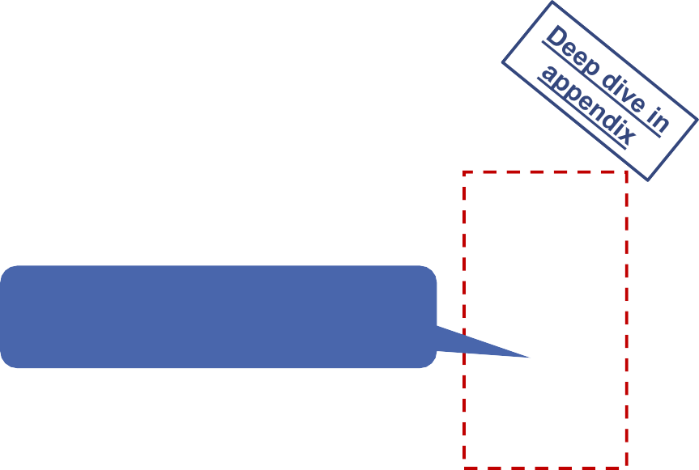
Discounting the cash flows of the realistic scenario, Tesla’s fair EV is USD 55.8bn which
translates into an equity value of USD 42.3bn that is 17% below Tesla’s market cap
DCF ENTERPRISE VALUE DERIVATION
Realistic free cash flow to equity projection Enterprise to Equity Value bridge
Free cash flow to equity of Tesla, in million USD, 2016-2030e In USDm
_{8,062} 8,440
55,819
Cumulative FCF 2019e-2030e
$51bn
3,878
7,135
16,002
6,356
1,390
42,305
5,752
4,666
5,076
Compared to Tesla’s market cap*, our analysis suggests that the market overvalues Tesla by 17%
3,001
2,220
379
674
Enterprise value
Cash and ST investments
Total debt
Minority interest
Equity value
-295
-700
Key valuation parameters
Balance sheet date | 12/31/2018
Valuation date | 02/22/2019
WACC | 10.3%
Terminal growth rate | 2%
Terminal value EBIT margin | 10%
-2,730
Tesla will generate positive cash flows starting from 2020 onwards which is driven by positive sales and margin developments
-5,266
2016 2017 2018 2019e2020e2021e2022e2023e2024e2025e2026e2027e2028e2029e2030e
Actuals Realistic case
Note: *: Based on market cap on 02/22/2019
Source: Own analysis based on financial statements from Thomson Reuters
Executive |  | Market |  | Strategic Fit | Financial | Feasibility |  | Alternative |  | Conclusion | | 43
Summary |  | Analysis |  |  | Analysis |  |  | Solution

Slide 44
Based on the multiple and DCF valuation, the fair EV of Tesla is USD 55bn that translates
into an equity value of USD 41.5bn which is 18% below the current market valuation
FAIR ENTERPRISE VALUE
Football field Weight* Implied multiples from valuation
Tesla’s Enterprise Value, in billion USD, as of February 22, 2019
EV / Sales 2019e EV / EBITDA 2019e
Estimated EV range:
$49.6bn – $60.5bn
Low High
1.1x 1.5x
Low High
10.0x 13.6x
Trading multiples
EV / Sales
2019e
31.5
43.0
Current EV based on market cap: $64.6bn
5%
EV / Sales
EV / EBITDA
EV / Patents EV / Engineers
EV / Sales WACC: 10.4%
EV / EBITDA 2019e
30.9 37.2
5%
1.1x
1.3x
9.8x
11.8x
EV / Patents**
56.5 63.2
5%
2.0x
2.2x
17.9x
20.0x
EV / Engineers***
91.0
105.0
5%
3.2x
3.7x
28.8x
33.3x
Transaction multiples
EV / Sales
2019e
28.7
40.2
5%
1.0x
1.4x
9.1x
12.7x
DCF
Average EV: USD 55bn
50.2 61.4 75%
2.1x
15.9x
19.5x
WACC: 10.4% 1.8x
Note: *: Weight assigned in calculation of final EV range; **: Number of patents related to EVs; **”: Number of engineering FTEs dedicated to EVs Source: Team analysis based on financial statements from Thomson Reuters
0 10 20 30 40 50 60 70 80 90 100 110
Executive |  | Market |  | Strategic Fit | Financial | Feasibility |  | Alternative |  | Conclusion | | 44
Summary |  | Analysis |  |  | Analysis |  |  | Solution

Slide 45

III
FINANCIAL ANALYSIS
1 2
COMPARABLES DISCOUNTED CASH FLOW
Trading and Business case transaction multiples forecasting and DCF
3
SYNERGIES
Assessment of potential synergies

Slide 46










Reducing management headcount, using Tesla’s battery technology and scaling up to
decrease supply/demand gap are the most tangible synergies that can be quantified
OVERVIEW SYNERGIES
Quanti- fication
Synergies based on GM and Tesla merger
Rationale
Administration
Real estate costs through shared headquarters • Strategic relevance for Tesla
Analyze management headcount and reduce organizational chart • Relevant - To be explored further
Profit from Cruise technology in Tesla’s cars • Inherently different technologies
R&D
Use of Tesla’s battery technology in GM’s EV models (Chevrolet Bolt, Cadillac, etc.) • Relevant – To be explored further
Shared information technology • Long-term, hard to quantify
Production & Assembly
Scale-up Tesla’s production to fully satisfy current demand and maximize
capacity profiting from GM financial backing and expertise
Relevant - To be explored further
Start of Tesla products being sold through traditional distribution channels, with higher negotiation power from GMs experience for scale-up
A USP of Tesla is their fully owned distribution network with specialists not commissioned based on sales for objectivity purposes
Distribution
Post-sale
Similar maintenance procedures
Reduce customer service teams
Only overlap in EV maintenance
Specialized Tesla’s customer service would be difficult to replicate
Few potential Tesla and GM synergies based on their respective strategic profiles are quantizable
Deep-dive in and detailed quantification in next slides
Source: Own analysis
Executive |  | Market |  | Strategic Fit | Financial | Feasibility |  | Alternative |  | Conclusion | | 46
Summary |  | Analysis |  |  | Analysis |  |  | Solution

Slide 47

Reducing administrative headcount and managing Tesla’s supply and demand gap could
yield up to USD 4.5bn in synergies after a GM-Tesla merger
ADMINISTRATIVE AND PRODUCTION SYNERGIES
Savings in executive and top management compensation Management of Tesla’s demand and supply gap
In million USD
Supply
898
997
728
784
749
Model S, X Model 3 Other
583
628
676
196
490
625
490¹
542
58
94
135
182
380
27
250
546
588
Y1
Y2 240
Y3
235
Y4
Y5
Y6
515
525
533
540
240
Y0 Y1 Y2 Y3
Expected synergies
Teslas’ executive and top management compensation
Gap
170
176
Y4 Y5 Y6
GM’s executive and top management compensation Combined executive compensation after merger
67
3
Y2 Y3 Y4 Y5
Main assumptions and valuation**
Y1
Y6
Main assumptions and valuation*,**
A certain share of general, administrative and management functions will overlap between both organizations and bear potential for elimination
Some compensation, such as the Elon Musk salary, cannot be addressed in this exercise based on feasibility constraints
This overlap will be restructured from 10% in Y1, up to 50% in Y6
Currently, the gap of Tesla is rooted in the penetration of key markets
GM would be able to reduce Tesla’s mismatch between demand and supply by 20% in Y1, vs. 70% in year 6
The gap will be smaller as Tesla becomes more mature, and so will the synergies between both entities
NPV = $2.2bn
NPV = $1.7bn
NPV = $2.5bn
NPV = $2.9bn
Note: *: Estimated based on executive’s compensation schemes from the annual report and press research; **: Discounted at a WACC of conglomerate which equals 7.1% (see excel model) Source: Thomson Reuters (2019), Tesla (2018), General Motors (2018a), New York Times (2018)
Executive |  | Market |  | Strategic Fit | Financial | Feasibility |  | Alternative |  | Conclusion | | 47
Summary |  | Analysis |  |  | Analysis |  |  | Solution

Slide 48
Applying Tesla’s battery technology, which has been proven to be the most advanced in
the market, to all GMs EVs could yield synergies of USD 2.7bn following the merger
TECHNOLOGICAL SYNERGIES
Comparing the price of Tesla’s batteries vs. GMs…
Main assumptions and valuation*
In USD per kWh
145
Price of Tesla’s battery ($/kw) Price of GM’s battery ($/kw)
116 116
Tesla’s batteries are the most advanced large-scale lithium batteries in the market at the moment, following a cooperation with Panasonic
GM’s battery prices, while less efficient than Tesla YTD, are expected to go under USD 100/kWh in 2021, following efforts of the company to develop an all-new platform
The difference in performance will be much smaller in the future, but applicable to more car units. Nevertheless, we expect Tesla to be able to retain its competitive advantage in the years to come
At the same time, GM is planning a full scale of its BEV production:
104
96
99
91
94
87
89
82
85
78
80
76
74
Y1 Y2 Y3 Y4 Y5 Y6
… and estimating to which models it would apply
Y7
Y8
In thousand car units
927
Cadillac will release its first EV model in 2021
GM plans to bring to the market 20 new electric vehicles by 2023, and produce around 1m units by 2026
Its 2019 Volt, the PHEV option, has been discontinued
Chevrolet EVs
Cadillac EVs
Other GM brands’ EVs
620
384
253
71
141
NPV = $2.7bn
30
39
Y1 Y2 Y3 Y4 Y5 Y6 Y7
Note: *: Discounted at a WACC of conglomerate which equals 7.1% (see excel model) Source: Own analysis, InsideEVs (2019b)
Y8
Executive |  | Market |  | Strategic Fit | Financial | Feasibility |  | Alternative |  | Conclusion | | 48
Summary |  | Analysis |  |  | Analysis |  |  | Solution

Slide 49

GM would lose around USD 26.2bn on the acquisition after accounting for a premium
over Tesla‘s current market capitalization that is required to convince shareholders to sell
EV – PURCHASING PRICE COMPARISON
The price to be paid for Tesla is significantly higher than its added value for GM
In billion USD
Estimated value of Tesla Estimated purchasing price of Tesla
1
Comparable premium paid on past M&A transactions
Ø 37.5%
Synergies
Market cap
Average premium* paid on US Industrials M&A transactions in 2016
and 2017 was
Equity value
7.4
45.6%
DCF
29.4%
50.9
2016
²⁰¹⁷ 37.5%
41.5
1
2
Comparable premium
Elon Musk premium
Elon Musk holds 20% of Tesla and is
its biggest shareholder
Tesla shareholders are often
attached to Musk’s vision
Might require an additional premium of 10%
Estimated loss on an investment in Tesla equals USD 26.2bn
19.1
2
Elon Musk premium
5.1
Note: *: Premium calculated to four week stock price Source: Hershorn (2018, Thomson Reuters)
Executive |  | Market |  | Strategic Fit | Financial | Feasibility |  | Alternative |  | Conclusion | | 49
Summary |  | Analysis |  |  | Analysis |  |  | Solution

Slide 50
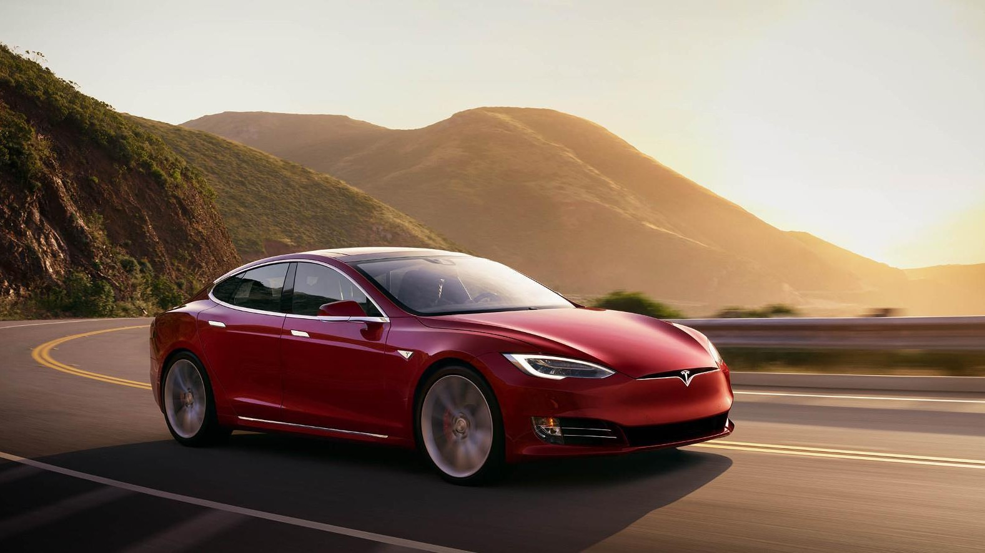
IV
FEASIBILITY
Beyond the value of
Tesla

Slide 51
Acquiring Tesla by means of cash is not a viable option because either there would be no
synergies, or GM would overstep its financial capacity
ACQUISITION/CASH DEAL
Acquiring a minority stake lacks benefits GM’s financing capacity does not allow to acquire a majority stake of Tesla
Net debt / EBITDA ratio; Below mix of financial sources for payment
GM + Tesla via
GM standalone
GM + Tesla via
debt raise
5.9x
equity raise
5.0x
3.9x
A minority stake could allow to pressure for a seat on the board of directors, access to insider information, and the like
Yet, Elon Musk has a lot of decision power and would most likely not approve GM to exercise power
Therefore, none of estimated synergies would materialize
Cash Equity Debt
18.0
Cash Equity Debt
18.0
20.0
0.0
0.0
20.0
GM is already highly levered
In order to control Tesla, GM needs to acquire 51% of Tesla’s equity, i.e. a purchasing price of
$38.3bn (incl. premium)
GM has USD 26.8bn cash
as of YE2018
Requires one of the largest equity issuances ever*
Shareholders would be massively diluted
Leverage increases to an unsustainable level
Requires one of the largest debt issuances ever*
GM might loose its investment grade credit rating
Leverage increases to an dangerous level
No synergies to be realized, therefore, unviable option for GM
Note: *: Overview about the biggest deals can be found in the appendix Source: Ouimet (2012), Bloomberg (2019)
Executive
Summary
Market Strategic Fit
Analysis
Financial
Analysis
Feasibility
Alternative
Solution
Conclusion
| 51

Slide 52
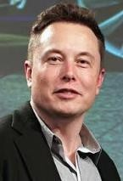
A merger would result in an ownership structure with Elon Musk as the major shareholder,
which may not be desirable for GM
MERGER/EQUITY DEAL
Tesla’s ownership structure Evolution of GM’s ownership structure
In % of its market capitalization as of February 22, 2019 In % of its market capitalization as of February 22, 2019
USD 75.1bn
Before merger After merger
7%
Elon Musk would become the major shareholder of GM!
19%
11%
7%
7%
5%
4%
USD 50.9bn
8%
3%
5%
3%
19%
5%
3%
3%
_{5%} 8%
63%
Elon Musk
Baillie Gifford & Co.
T. Rowe Price Associates Fidelity Mngmt & Research Others*
67%
2%
3%
5%
73%
63%
Elon Musk
Baillie Gifford & Co. Capital World Investors
Concerns
The Vanguard Group, Inc. Brock Capital Group
T. Rowe Price Associates
Fidelity Mngmt & Research Berkshire Hathaway Inc.
Others*
Current
After offer price
Elon Musk has been Tesla’s CEO since 2008, and emotionally very involved in his company
Musk lacks professionality, e.g. he was punished by the SEC because of a tweet about his desire to make Tesla private (fine of $20m for both Tesla and Musk)
Can GM allow itself to have a person with such an unpredictable behavior as major shareholder?
Note: *: Parties holding less than 5% of outstanding shares; **: Average premium to 4 week stock price for M&A transactions in the US Industrials sector between 2016 and 2017 Source: Thomson One (2019), Nasdaq (2019), Hershorn (2018, Thomson Reuters)
Assumptions
Tesla market capitalizaton | USD 50.9bn (as of 02/22/2019)
GM market capitalization | USD 56.3bn (as of 02/22/2019)
Acquisition premium | 47.5%**
Executive
Summary
Market Strategic Fit
Analysis
Financial Feasibility
Analysis
Alternative Conclusion
Solution
| 52

Slide 53



The acquisition is threatened as well in other dimensions, especially regarding the post-
merger integration and the measures set by Tesla to avoid unwanted M&A operations
OTHER DIMENSIONS
Areas of concern following GM’s acquisition of Tesla
Threat assessment
Descriptive assessment Threat level
Overall threat
Description
Willingness to prevent M&A operations that lead to a monopoly or drastically reduce competition (Sherman Act & Clayton Act)
Already concentrated market
Strong increase of the market concentration
Resulting monopoly in the EV segment
HHI* lower than 1,500
Increase of HHI* of less than 200 points
Low Low
Antitrust regulation
Rising players in the EV segment, but
strong leadership of Tesla
Medium
Merging different organizations (culture, values) can cause uncertainty among workers, leading to lower productivity and failure of the acquisition
Difficulty to engage the teams of
the acquired company
Difficulty to align management teams’ interests
Tesla & GM’s values differ which may
hinder employee’s engagement
Elon Musk acting as a charismatic and strongly independent leader: may be reluctant to follow GM’s objectives
High
Post-merger integration
High
Defense strategies set up by Tesla’s management in advance to deter unwanted acquisitions
Voting structure preventing acquisitions
Supermajority voting structure (two thirds of the shares required for any major change, e.g. acquisitions)
Elon Musk owns c. 19% of Tesla and considered getting the company private
High
Preventive measures set by Tesla
Resistance of shareholders
High
Tendency of markets to value a diversified group at less than the sum of its part – as issues arising from an M&A operation can offset the benefits of controlling several companies
Strong diversification
Limited strategic rationale for the acquisition
Different management styles
Acquisition within the auto industry
Limited synergies (cf. financial analysis)
Low Low
Conglomerate discount
Tesla puts emphasis on a very flat management style, which may be hard to achieve in a bigger structure
Medium
Note: *: The Herfindahl-Hirschman Index is a measure commonly used in economics to assess the concentration of a market Source: Xerfi (2018), DOJ (2019), FTC (2019), Korus (2016, Ark Invest), Boudette (2018, New York Times), Thomson One (2019)
Low threat
High threat
| 53
Executive
Summary
Market Strategic Fit
Analysis
Financial Feasibility
Analysis
Alternative
Solution
Conclusion

Slide 54
General Motors should not acquire Tesla
An acquisition of, or merger with, Tesla would destroy around USD 26.2bn of value
Several challenges fundamentally question the feasibility of such a transaction
Our multiples and DCF valuations suggest that Tesla’s equity is currently 18% overvalued
Using cash to acquire a minority stake of Tesla would lack synergies, and a majority stake would overstep GM’s financial capacity
Tesla’s shareholders likely require a premium of 47.5% on top of the current market cap in order to sell their shares
Merging with Tesla would result in an ownership structure where Elon Musk is the major shareholder of the conglomerate
This purchasing price does not justify USD
7.4bn in estimated synergies
Additionally, there is a risk of post-merger integration and preventive measures put in place by Tesla
Executive
Summary
Market
Analysis
Strategic Fit
Financial
Analysis
Feasibility
Alternative
Solution
Conclusion
| 54

Slide 55
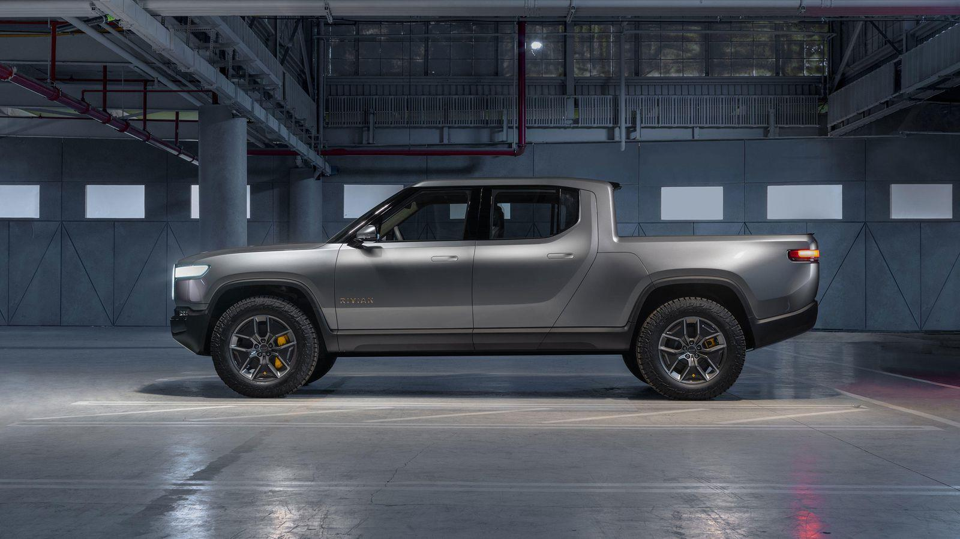
V
ALTERNATIVE SOLUTION
The road ahead

Slide 56





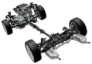



There are multiple alternative investment opportunities that GM could exploit, but the
most attractive one is to expand its product portfolio by EV truck
ALTERNATIVE INVESTMENT OPPORTUNITIES
Product opportunity
Expand EV product portfolio
Demand continues to grow for pickup trucks, and a market for electric versions is emerging This represents an opportunity to acquire a carmaker of electric trucks or develop them inhouse GM’s current efforts within EV trucks
GM has not announced any plans to launch an electric pickup truck GM’s next-gen EV platform is not designed to support a truck GM’s brand portfolio could need a modernization or new addition
Considering GM’s core customers, GM should acquire or develop an EV truck
R&D opportunity Market opportunity
Invest in new battery technology
Go solo in China with EV venture
The battery is the most expensive part of EVs, and many new battery technologies show potential
In 2018, the Chinese government scrapped the 50% ownership cap for EV producers*
This represents an opportunity for GM to establish a local EV venture independently
This represents an opportunity to acquire a battery maker or invest in a new battery technology
GM’s current efforts within batteries
In 2018, GM expanded its battery
lab in Michigan to accelerate efforts
GM also teamed up with Honda to build next-gen batteries for EVs
GM is developing faster-charging batteries with Delta Electronics too
GM’s current efforts in China
$1,981M
In 2018, GM earned USD 1,981m in equity income from its highly successful JVs in China
GM’s success in China is partly due to its partnership with SAIC, which is regarded as one of the strongest partners in the region
2018
Since GM is already doing well, GM should focus its efforts on other options
Given GM’s successful JVs with its
partners, GM should not go solo
Note: *: In 2020, the same limits will be removed for automakers of commercial vehicles, and in 2020, for passenger vehicles as well Source: Team analysis, Edelstein, S. (2018, The Drive), Lambert (2018e, Electrek), Zhang, Y. and Hull, D. (2019, Bloomberg)
Deep dive on following slide
Executive |  | Market |  | Strategic Fit |  | Financial |  | Feasibility | Alternative | Conclusion | | 56
Summary |  | Analysis |  |  |  | Analysis |  |  | Solution

Slide 57
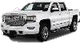
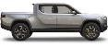
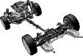

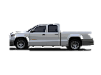





GM could either develop an EV truck by itself, acquire an EV truck producer, or design a
truck in a partnership, but acquiring an existing EV truck maker holds the most promise
WAYS TO EXPLOIT PRODUCT OPPORTUNITY
Acquire
Buy a company that produces one
Will allow GM to rapidly bring electric powertrain technology into its top-selling truck line and potentially a hyped brand as well However, it might be expensive, and difficulties with integration could limit the potential upside Feasibility of acquiring a producer
GM ended 2018 with ~USD 23.5bn in cash and has more experience than most in buying and integrating companies and brands However, GM risks overpaying for technology that is not good enough
Acquiring an EV pickup truck maker is very attractive, if a target can be found
Develop Cooperate
Develop the EV pickup truck alone
Establish a joint venture or an alliance
Would allow GM to develop an EV pickup truck from the ground up and be in full control of the design
Would allow GM to design the EV powertrain technology for trucks cheaper and with less risk
However, it would involve sacrificing control over a key part of the EV truck and sharing the gains with a partner as well
However, it would take time to develop the EV powertrain, and in the meantime GM’s competitors might launch EV trucks
Feasibility of developing alone
GM is already the largest pickup truck maker and also has plenty of experience producing EVs
Feasibility of cooperating with partner
GM has plenty of experience in establishing JVs, also within research and development
However, GM would risk that its partner breaks up the agreement to exploit the tech by itself
However, GM would risk losing the opportunity for a “first mover advantage” in making EV trucks
GM is greatly positioned to build an EV pickup truck, but it would take too long
Developing an EV truck in a partnership is too risky and limits the upside
Source: Team analysis, General Motors (2019b)
Deep dive on following slide
Executive |  | Market |  | Strategic Fit |  | Financial |  | Feasibility | Alternative | Conclusion | | 57
Summary |  | Analysis |  |  |  | Analysis |  |  | Solution

Slide 58



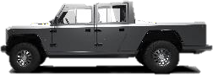



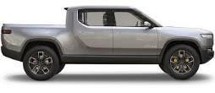

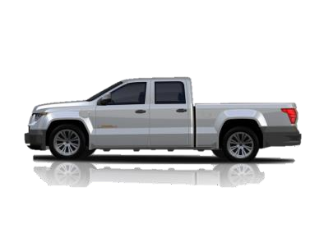


Multiple companies are currently trying to bring EV trucks to market, but only Rivian is far
enough in the development process and attractive enough to consider for an acquisition
POTENTIAL ACQUISITION TARGETS
Company EV Truck model Specifications Launch date and price Operations and finance
Verdict
0-60 MPH in 5 seconds
120 mph top speed
500 miles of range
5,000 lbs payload
17,000 lbs tow capacity
Production of the XT might begin in 2020
No price has been announced
Does not plan to make more than 100 units at the beginning
Funding still not fully secured to launch
The XT Pickup
0-60 MPH in 4.5 seconds
100 mph top speed
200 miles of range
5,000 lbs payload
7,500 tow capacity
Production of the B2 might begin in 2020
The B1 is supposed to start around USD 60,000
Only renderings of the B2 exist right now
Is still looking for partners to get its first vehicle into production
B2 Pickup Truck
0-60 MPH in 3 seconds
125mph top speed
400 miles of range
1,763 lbs payload
11,000 lbs tow capacity
Production of the R1T will begin in 2020, together with Rivian’s R1S SUV model
R1T will start at $69,000
In January 2019, Rivian secured USD 700m of funding by Amazon
It already has a
functional factory
Rivian R1T
0-60 MPH in 5.5 seconds
80 miles of electric range
Gasoline range extender
2,200 lbs payload
5,500 lbs tow capacity
Production of the W-15 will start in 2019
The W-15 has a planned starting price of $52,000
In January 2019, Workhorse secured USD 35m in financing from Marathon Asset
The W-15*
Management
Deep dive on
Note: *: The W-15 is not an actual pure BEV, but a plug-in range extended electric pickup (PHEV)
following slide
Very attractive Not attractive
Source: Atlis Motor Vehicles (2019), Bollinger Motors (2019), Lambert, F. (2018f, 2018g, Electrek), O’Kane, S. (2018, Verge), Randall C. (2019, Electrive.com), Rivian (2019), WorkHorse (2019)
Executive |  | Market |  | Strategic Fit |  | Financial |  | Feasibility | Alternative | Conclusion | | 58
Summary |  | Analysis |  |  |  | Analysis |  |  | Solution

Slide 59


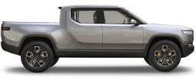
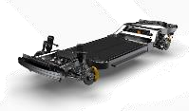
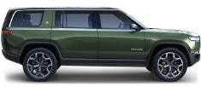

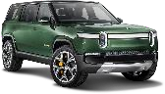
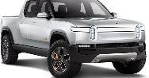




Rivian’s products are a perfect fit with GM’s customers, and its skateboard platform can
be used for future GM vehicles as well, while its brand is already hyped by customers
ATTRACTIVENESS OF RIVIAN AS TARGET
Rivian’s products would be a perfect fit with GM’s customers…
Rivian’s brand is very hyped among consumers and investors…
“I am stunned by the specs here. We are talking about a best-case scenario for an all-
electric pickup truck”
- Fred Lambert Editor in Chief, Electrek
“If Rivian can deliver on its promise… then the EV market will surely gain itself a whole
new sector”
- Wired’s best EVs from the LA Motor Show
“Tesla’s domination of the electric vehicle market is unsustainable and will soon be disrupted by start-up Rivian”
- Adam Jonas Morgan Stanley Analyst
Rivian R1T
All-electric
5-passenger pickup truck
Rivian’s skateboard platform
Rivian R1S
All-electric
7-passenger SUV
Is built from a clean sheet
Can be modified and used
for future GM vehicles too
Because of the shared electric powertrain, the R1T and R1S have 91% shared components – future GM vehicles could have the same
… and Rivian is already very far in the development process
… and Rivian’s technologies are also quite attractive for GM
10 years of experience in building cars
Founded in 2009 by
M.I.T. engineer
Has been working on EVs since 2011
Already owns a fully functional factory
Bought auto plant in 2017, previously owned by Mitsubishi Motors
Employs 700 people
Both vehicles will go on sale in 2020
Rivian aims to sell a
total of 20,000
vehicles in 2021
and 40,000 in 2022
Battery packs
Battery sizes all the way up to 180 kWh
Have the highest capacity of any other passenger EV
Self-driving tech
Hardware suite enables “Level 3”* and includes Lidar, making it compatible with GM Cruise’s technologies
Connected car
Cloud-based platform that learns driver’s preferences and adapts to his or her driving habits
Note: *: Level 3 ("eyes off") automation: The driver can safely turn their attention away from the driving tasks, e.g. the driver can text or watch a movie
Source: Charlton, A. (2018, Wired), Lambert, F. (2018h, Electrek), Loveday, S. (2018, InsideEVs), Rivian (2019), Seppala, J. (2018, Engadget) Sheetz (2019, CNBC), Tannert, C. (2019, Forbes)
Executive |  | Market |  | Strategic Fit |  | Financial |  | Feasibility | Alternative | Conclusion | | 59
Summary |  | Analysis |  |  |  | Analysis |  |  | Solution

Slide 60








To acquire Rivian, GM must account for the varied profiles of the investors, especially
since Rivian’s valuation is very uncertain and ranged between USD 1.2bn and 4bn
VALUATION AND FEASIBILITY OF ACQUIRING RIVIAN
Rivian has gone through two major financing rounds… … And the acquisition has to account for different shareholders
Debt
Official shareholders based on currently publicly available data
Equity |  | 500 |  | 700
 |  | 200
0 | 1 | 300
Dec-11 | Aug-12 | May-18 |  | Feb-19
Rivian has gone through two major financing rounds in the last 12 months to be able to expand capacity by buying a factory and employing more talent
… But this has not made its valuation any clearer…
According to the current situation…
Rivian does not require additional liquidity to de-risk its goal of producing an all-electric pickup by 2020
Shareholders are committed to seeing the company
succeed and would not part with their shares lightly
1.2-4
Remaining Invested capital
But…
Rivian will still need an automaker’s expertise to fully scale its production in the next years, as Amazon is looking at Rivian as a partner to develop its delivery vehicles
GM has the financial capabilities to go through the acquisition, even with at a substantial premium, which is justified based on its strategic relevance
1,2
2019 EV Valuation
While past investments provide an idea of the value of Rivian, the share acquired by Amazon in its February 2019 investment round has not been officially disclosed
Source: Pyper (2019, GTM), Prenzler (2018, AdaptBN)
Executive |  | Market |  | Strategic Fit |  | Financial |  | Feasibility | Alternative | Conclusion | | 60
Summary |  | Analysis |  |  |  | Analysis |  |  | Solution

Slide 61



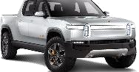
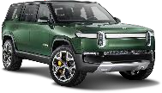
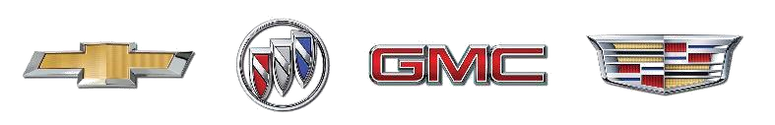

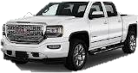
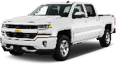

Rivian’s brand should be positioned as a premium brand, while its underlying architecture
should be used to develop cheaper electric trucks under the Chevrolet and GMC brands
POST-ACQUISITION STRATEGY
Rivian’s brand should be positioned as a premium brand…
Rivian’s powertrain technology should be used extensively…
The world’s first Electric Adventure Vehicles
The Chevrolet Silverado pickup truck
Rivian’s platform
Will serve as GM’s next-generation battery-electric architecture for EV pickup trucks
The GMC Sierra pickup truck
Starting price: $29,000
The GMC Sierra is known for being a bit more luxurious truck
Starting price: $28,285
The Silverado is labeled as the more affordable truck
The R1T pickup truck and the R1S SUV should be branded as premium vehicles
The starting price should be kept around USD 70,000
The brand should be used only for premium EVs
Focus should be on delivering the highest quality
The GMC Sierra and the Chevrolet Silverado already share the same underlying platform, as well as conventional internal combustion powertrains
… and be promoted as part of GM’s portfolio of core brands
… in order for GM to maximize the value of the Rivian acquisition
No development cost
Will eliminate cost of developing powertrain
Economies of scale
Will decrease vehicle production cost
Choice for the consumer
“The GMC is a GMC”
“The Chevy is a Chevy”
Rivian’s logo
Source: Eisenstein (2019, CNBC), General Motors (2018b), Smith, A. (2019, PonyParts)
Executive |  | Market |  | Strategic Fit |  | Financial |  | Feasibility | Alternative | Conclusion | | 61
Summary |  | Analysis |  |  |  | Analysis |  |  | Solution

Slide 62
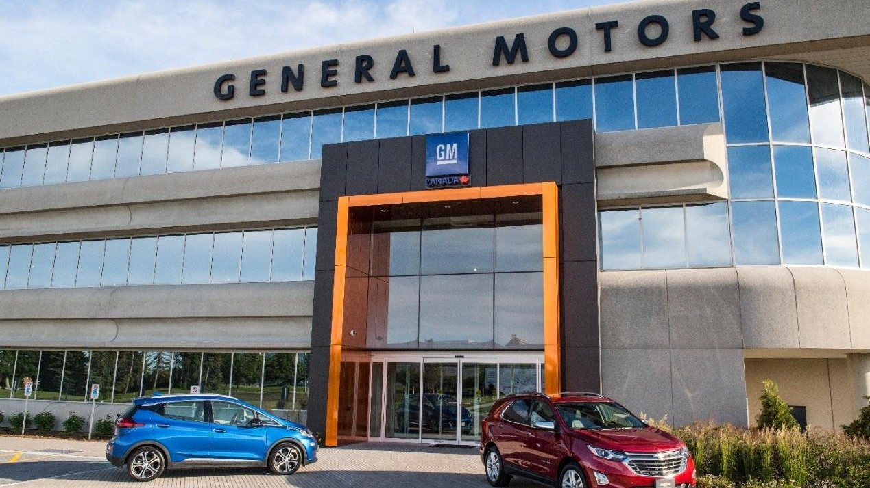
VI
CONCLUSION
Sometimes it is simply
not meant to be

Slide 63


THE CONCLUSION
GM should not acquire Tesla, but instead acquire Rivian, an EV truck manufacturer
whose products and brand will have strategic value for GM in the future EV landscape
Should General Motors acquire Tesla?
How is GM’s and
Tesla’s strategic fit?
Despite having the second largest share of EVs sold in the US in 2018, GM is still highly dependent on pickup trucks and SUVs that are causing very high emissions
GM could use Tesla’s brand and products, while Tesla could leverage GM’s expertise in scaling
How much is Tesla
worth?
Tesla’s fair valuation is estimated at an EV and Equity Value of USD 55bn and 41.5bn, respectively
GM would lose around USD 26.2bn on the acquisition after accounting for synergies and a reasonable
premium over Tesla‘s current market capitalization that is required to convince shareholders to sell
How feasible is an
acquisition?
Acquiring Tesla by means of cash is not viable due to either the lack of synergies or financial capacity
A merger would result in an ownership structure where Elon Musk is the major shareholder
There are concerns about the post-merger integration and Tesla’s preventive M&A measures
GM should not buy Tesla
What should GM do instead?
Acquiring an existing EV pickup truck maker is the most promising solution for GM
Rivian is the most attractive target due to its product portfolio and brand
The Rivian brand should then be kept as a premium brand, while its underlying powertrain technology should be used to develop cheaper electric pickup trucks under the Chevrolet and GMC brands
Executive
Summary
Market
Analysis
Strategic Fit
Financial
Analysis
Feasibility
Alternative
Solution
Conclusion
| 63

Slide 64
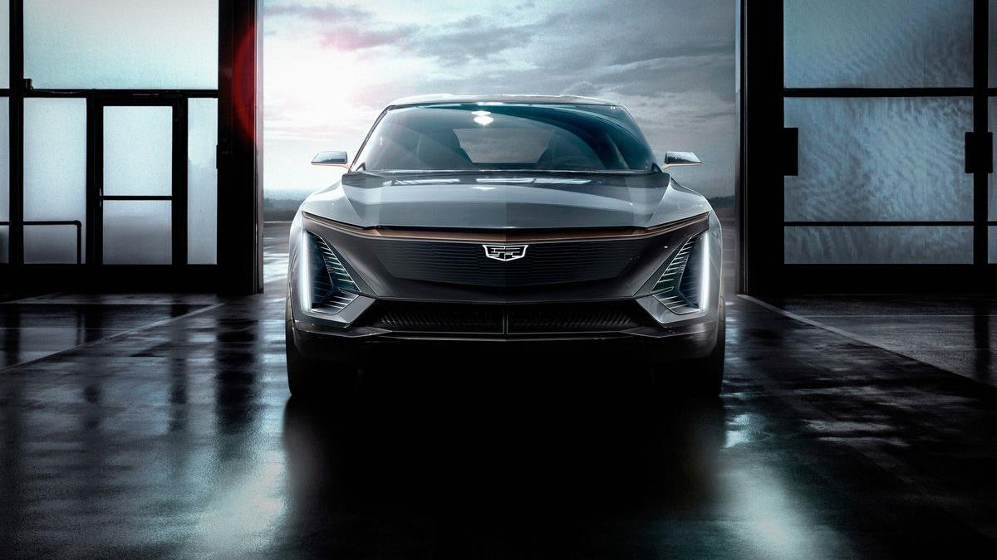
–
APPENDIX
More insights
(yes, more)

Slide 65
Table of contents
I. | Referenced deep dives Strategic fit Financial analysis Feasibility Alternative solution | p. 67
II. | Additional insights Market analysis Strategic fit | p. 76
Appendix

Slide 66
Table of contents
I. | Referenced deep dives Strategic fit Financial analysis Feasibility Alternative solution | p. 67
II. | Additional insights Market analysis Strategic fit | p. 76
Appendix

Slide 67
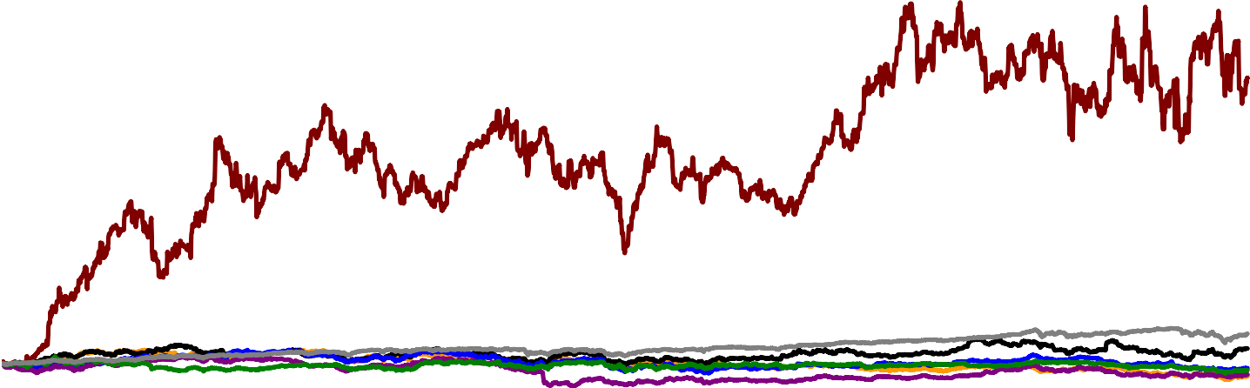





Based on 5 key differences between Tesla and traditional OEMs, we reach the conclusion
that this peer group should not be retained as a peer
FINANCIAL ANALYSIS – TRADING MULTIPLES
Return 13a-18a
5 key differences between Tesla and traditional OEMs
Stock prices of traditional automotive manufacturers peer group
1200
The growth profile of Tesla is vastly different, with part of the demand for their cars still unmet
Tesla just became EBITDA positive in 2018, vs. the rest of the industry that shows rather stable profitability
The scale of traditional OEMs
dwarfs Tesla’s current production
Tesla constantly remodels its assembly line, vs. other automakers that keep it the same for years
Fast vehicle updates are common in Tesla, realizing fixes via overnight software download or make physical changes fast
1000
743%
800
600
-27%
-11%
-16%
39%
-32%
400
200
0
feb maj aug nov feb maj aug nov feb maj aug nov feb maj aug nov feb maj aug nov feb maj aug nov
13 13 13 13 14 14 14 14 15 15 15 15 16 16 16 16 17 17 17 17 18 18 18 18
Tesla Inc
Bayerische Motoren Werke AG S&P 500 INDEX/d
Ford Motor Co Volkswagen AG
General Motors Co Nissan Motor Co Ltd
Based on this evidence, traditional automakers are not retained as a peer
Source: Bloomberg (2019)
Appendix

Slide 68











Through selected transaction multiples in the four industries, we estimate an EV / Sales
multiple for Tesla of 1.2x
FINANCIAL ANALYSIS – TRANSACTION MULTIPLES
M&A transactions
# | Date |  | Target company | Description |  | Buyer | Deal value ($m) | EV/ Sales | EV/ EBITDA
1 | Jan-08 |  | Jaguar Land Rover | Automotive manufacturer |  | Tata Motors | 2,300 | 0.3 | Negative EBITDA
2 | Jan-09 |  | Chrysler | Automotive manufacturer |  | Fiat | 10,400 | 0.6 | 3.2
3 | Mai-15 |  | National Electric Vehicle Sweden | Company engaged in the manufacturing of electric automobiles |  | GaoXin BoHua Investment Co | 930 | 1.1 | n.a.
4 | Jul-15 |  | Agile Electric Sub Assembly | Indian eletric motor manufacturer |  | Igarashi Electric Works | 118 | 1.2 | n.a.
5 | Oct-16 |  | Mitusbishi Motors Corporation | Automotive manufacturer |  | Nissan Motor Co | 2,486 | 1.4 | 6.0
6 | Jan-17 |  | SolarCity | Manufactures and installs residential and commercial solar panels |  | Tesla | 2,600 | 4.2 | Negative EBITDA
7 | Jan-17 |  | SPower | Private owner of operating solar assets |  | AES/AIMCO | 853 | 1.9 | Negative EBITDA
8 | Feb-17 |  | Argo AI | Start-up developing softwares for self-driving technology |  | Ford | 1,000 | 1.2* | n.a.
9 | Oct-18 |  | SunPower | Energy company that designs and manufactures crystalline silicon photovoltaic cells and solar panels |  | Total | 1,300 | 0.7 | Negative EBITDA
Max |  |  |  |  |  |  |  | 4.2
Average |  |  |  |  |  |  |  | 1.4
Median |  |  |  |  |  |  |  | 1.2
Min |  |  |  |  |  |  |  | 0.3
Note: When not available in USD, the Sales and EV were converted to USD using the annual average exchange rate. *Bloomberg estimate
Source: MergerMarkets (2019), Thomson One (2019), Bloomberg (2019)
Appendix

Slide 69

In the realistic scenario of our DCF analysis, we value Tesla at an EV of USD 55.8bn
which translates into an equity value of USD 42.3bn
FINANCIAL ANALYSIS – DCF VALUATION
 | Actuals |  |  |  |  | Realistic case |  |  |  |  |  |  |  |  |  |  |  | Norm.
FYE 31/12 - USDm | 2014a | 2015a | 2016a | 2017a | 2018a | 2019e | 2020e | 2021e | 2022e | 2023e | 2024e | 2025e | 2026e | 2027e | 2028e | 2029e | 2030e | TV Year
Sales | 3’198 | 4’046 | 7’000 | 11’759 | 21’461 | 28’680 | 34’199 | 41’587 | 48’275 | 56’643 | 61’618 | 65’093 | 68’492 | 72’416 | 76’360 | 79’630 | 82’827 | 84’484
growth% | 58.8% | 26.5% | 73.0% | 68.0% | 82.5% | 33.6% | 19.2% | 21.6% | 16.1% | 17.3% | 8.8% | 5.6% | 5.2% | 5.7% | 5.4% | 4.3% | 4.0% | 2.0%
EBITDA | 45 | -294 | 280 | 4 | 1513 | 3155 | 4104 | 5406 | 7241 | 9063 | 9859 | 9764 | 10274 | 10862 | 11454 | 11945 | 12424 | 12588
% margin | 1.4% | -7.3% | 4.0% | 0.0% | 7.0% | 11.0% | 12.0% | 13.0% | 15.0% | 16.0% | 16.0% | 15.0% | 15.0% | 15.0% | 15.0% | 15.0% | 15.0% | 14.9%
EBIT | -187 | -717 | -667 | -1632 | -388 | 574 | 1368 | 2495 | 3862 | 5664 | 6162 | 6509 | 6849 | 7242 | 7636 | 7963 | 8283 | 8448
% margin | -5.8% | -17.7% | -9.5% | -13.9% | -1.8% | 2.0% | 4.0% | 6.0% | 8.0% | 10.0% | 10.0% | 10.0% | 10.0% | 10.0% | 10.0% | 10.0% | 10.0% | 10.0%
Tax rate | 27.9% | 27.9% | 27.9% | 27.9% | 27.9% | 27.9% | 27.9% | 27.9% | 27.9% | 27.9% | 27.9% | 27.9% | 27.9% | 27.9% | 27.9% | 27.9% | 27.9% | 27.9%
(-) Tax on EBIT | 52 | 200 | 186 | 455 | 108 | (160) | (381) | (695) | (1’076) | (1’579) | (1’717) | (1’814) | (1’909) | (2’018) | (2’128) | (2’220) | (2’309) | (2’355)
NOPAT | -135 | -517 | -481 | -1177 | -280 | 414 | 987 | 1800 | 2786 | 4086 | 4444 | 4695 | 4940 | 5223 | 5508 | 5743 | 5974 | 6094
(+) D&A | 232 | 423 | 947 | 1636 | 1901 | 2581 | 2736 | 2911 | 3379 | 3399 | 3697 | 3255 | 3425 | 3621 | 3818 | 3982 | 4141 | 4140
% Capex | 23.4% | 25.3% | 66.9% | 39.0% | 81.3% | 90.0% | 84.2% | 77.8% | 82.4% | 75.0% | 80.0% | 71.4% | 76.9% | 83.3% | 90.9% | 100.0% | 100.0% | 98.0%
(+) Stock-based compensation | 156 | 198 | 334 | 467 | 749 | 1147 | 1368 | 1663 | 1931 | 2266 | 2465 | 2604 | 2740 | 2897 | 3054 | 3185 | 3313 | 3379
% sales | 4.9% | 4.9% | 4.8% | 4.0% | 3.5% | 4.0% | 4.0% | 4.0% | 4.0% | 4.0% | 4.0% | 4.0% | 4.0% | 4.0% | 4.0% | 4.0% | 4.0% | 2.0%
(-) Capex | (990) | (1’674) | (1’416) | (4’196) | (2’337) | (2’868) | (3’249) | (3’743) | (4’103) | (4’531) | (4’621) | (4’556) | (4’452) | (4’345) | (4’200) | (3’982) | (4’141) | (4’224)
% sales | 31.0% | 41.4% | 20.2% | 35.7% | 10.9% | 10.0% | 9.5% | 9.0% | 8.5% | 8.0% | 7.5% | 7.0% | 6.5% | 6.0% | 5.5% | 5.0% | 5.0% | 5.0%
(-) Change in trade working capital | (442) | (345) | (2’113) | (1’995) | (327) | (1’974) | (1’463) | (1’958) | (1’773) | (2’217) | (1’318) | (921) | (901) | (1’040) | (1’045) | (867) | (847) | 864
% sales | 13.8% | 8.5% | 30.2% | 17.0% | 1.5% | 6.9% | 4.3% | 4.7% | 3.7% | 3.9% | 2.1% | 1.4% | 1.3% | 1.4% | 1.4% | 1.1% | 1.0% | 1.0%
Unlevered free cash flow | -1178 | -1915 | -2730 | -5266 | -295 | -700 | 379 | 674 | 2220 | 3001 | 4666 | 5076 | 5752 | 6356 | 7135 | 8062 | 8440 | 10253
Present value of free cash flows |  |  |  | 30% | 16’634
Present value of terminal value |  |  |  | 70% | 38’398
Enterprise value 31.12.2018 |  |  |  |  | 55’032
Future value factor |  |  |  |  | 1.01
Enterprise value 22.02.2018 |  |  |  |  | 55’819
EV - EquityV bridge |  |  |  |  |  | ual rat
+ Cash and ST Investments |  |  |  |  | 3’878 | pet th
- Total Debt |  |  |  |  | (16’002) | Per row
- Minority Interest |  |  |  |  | (1’390) | g
Total EV-EqV adjustments |  |  |  |  | (13’514)
Equity value |  |  |  |  | 42’304.9
Enterprise Value (€$bn)
WACC
Key valuation parameters
Balance sheet date | 12/31/2018
Valuation date | 02/22/2019
WACC | 10.3%
Perpetual growth rate | 2%
Perpetual EBIT margin | 10%
55.8 | 9.27% | 9.77% | 10.27% | 10.77% | 11.27%
1.0% | 61.2 | 56.0 | 51.4 | 47.4 | 43.8
1.5% | 64.1 | 58.4 | 53.5 | 49.2 | 45.3
2.0% | 67.4 | 61.2 | 55.8 | 51.1 | 47.0
2.5% | 71.2 | 64.3 | 58.4 | 53.4 | 48.9
3.0% | 75.6 | 67.9 | 61.4 | 55.8 | 51.0
e
Source: Own analysis based on financial statements from Thomson Reuters
Appendix

Slide 70
FINANCIAL ANALYSIS – DCF VALUATION
The equity betas for Tesla and General Motors were derived based on CAPM regressions
Tesla CAPM regressions
Return frequency
Weekly
Sample period (31/12/2018 - x years)
year
years
years
years
years
Average beta
S&P 500 |  |  | Nasdaq
Beta | t statistics | R-squared | Beta | t statistics | R-squared
1.3263965 | 3.2003615 | 0.1700186 | 1.1333018 | 3.7209910 | 0.2168628
1.3470997 | 4.0339210 | 0.1375850 | 1.1567973 | 4.6897035 | 0.1773750
1.5920039 | 5.9509014 | 0.1869628 | 1.3926345 | 7.0206576 | 0.2424601
1.5066548 | 6.8463311 | 0.1853594 | 1.3577518 | 8.0359592 | 0.2386630
1.5416553 | 7.4947275 | 0.1787910 | 1.4330957 | 9.0284881 | 0.2400893
1.4627620
1.2947162
Average beta S&P500 and Nasdaq
1.3787391
General Motors CAPM regressions
Return frequency Weekly
 | S&P 500 |  |  | Nasdaq
Sample period (31/12/2018 - x years) | Beta | t statistics | R-squared | Beta | t statistics | R-squared
1 year | 1.0076880 | 3.6675755 | 0.2119917 | 0.7081105 | 3.3454446 | 0.1828997
2 years | 1.1156166 | 5.3102361 | 0.2165815 | 0.7716598 | 4.7503322 | 0.1811547
3 years | 1.1839723 | 7.5532588 | 0.2703210 | 0.8400113 | 6.7938874 | 0.2306036
4 years | 1.2286241 | 9.4530649 | 0.3025471 | 0.8775339 | 8.1694879 | 0.2447034
5 years | 1.2354371 | 10.9813061 | 0.3185223 | 0.8820318 | 9.3305158 | 0.2523007
Average beta | 1.1542676 | 0.8158695
Average beta S&P500 and Nasdaq | 0.9850686
Source: Own analysis based on financial statements from Thomson Reuters
Appendix

Slide 71


The acquisition premium for M&A deals in the US Industrials sector is estimated at a
value of 37.5%
FEASIBILITY – PREMIUM
Premium estimates
Conclusion
2016 2017
Ø 37.5%
We use the 37.5% average premium to 4 week stock price as an estimate for the acquisition premium for M&A deals in the US Industrials sector
24.8%
24.0%
45.6%
29.4%
Average one-week deal premium
Median premium
Average premium to 4 week stock price
The other two metrics are left behind for the following reason:
the BCG estimate is a worldwide estimate, not specific to the automotive industry
the FactSet estimate, though specific to the US, is computed on an industry scope that is too broad
Year
2017
2019
2017
Location
Industry
Global
Global
Industrials
Source
BCG 2018 M&A
Market Report
USA
FactSet Flashwire
Monthly
Thomson Reuters
2017 M&A Review
World
Source: BCG (2019), Hershorn (2018, Thomson Reuters), FactSet (2019)
Appendix

Slide 72
FEASIBILITY – ACQUISITION/CASH DEAL
Overview about the largest equity and debt issuances of all time
Largest corporate bond deals ever (USDbn) Largest IPOs ever (USDbn)
Verizon, 2013 49 Alibaba, 2014 22
Actavis, 2015 21 Visa, 2008 18
AT&T, 2015 18 ENEL spA, 1999 17
Largest SEOs ever (USDbn)
Royal Bank of Scotland, 2008
HSBC, 2009
24
19
Fortis, 2007
19
Apple, 2013 17 16
15
Facebook, 2012
General Motors,
2010
Deutsche Telekom,
1996
AT&T, 2000
UBS, 2008
Medtronic, 2014 17
AbbVie, 2015 17
16
Rio Tinto, 2009
Imperial Tobacco,
2008
Credit Agricole,
2008
Banco Santander,
2008
Société Générale,
2008
Anheuser-Busch
Inbev, 2008
15
13
10
Roche, 2009
France Telecom,
2001
Visa, 2015 Charter Comms.,
2015
17
11
9
16
Kraft Foods, 2001
France Telecom,
1997
Telstra Corporation,
1997
9
9
16
7
8
16
6
8
Ø 20
Ø 13
Ø 14
Source: Backman (2016, Atlas), Renaissance Capital (2019), Statista (2019c)
Appendix
| 72

Slide 73
The US automotive industry is considered an unconcentrated market by the US antitrust
regulators: an acquisition is quite unlikely to fall under scrutiny
FEASIBILITY – OTHER DIMENSIONS – ANTITRUST REGULATION
Concentration analysis
Conclusion
Herfindahl-Hirschman index for selected US markets
The automotive industry has a Herfindahl-Hirschman Index below 1500, which means that the industry is considered by the antitrust regulators as an unconcentrated market
Level of
concentration
7,000
High
1,120
1,200
900
Moderate
Unconcentrated
US automotive Airlines Smartphone OS Smartphone vendors industry
Therefore, the likelihood that a merger in this industry would fall under the DOJ or the FTC scrutiny is quite low
Three major US Antitrust laws are preventing the development of monopolies
Sherman Act: prohibits new business combinations and stock purchase that result in the creation of a monopoly
Clayton Act: illegal for one company to purchase the stock of another company if their combination results in reduced competition within the industry
Hart-Scott-Rodino Antitrust Improvements Act: requires that acquisitions involving companies of a certain size cannot be completed until certain information is supplied to the federal government and a specified waiting period has elapsed
Note: The Herfindahl-Hirschman index for selected industries is based on market shares of 2018 (for the automotive industry) and of 2016 (all other industries) Source: Xerfi (2018), DOJ (2019), FTC (2019), Korus (2016, Ark Invest)
Appendix

Slide 74
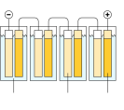
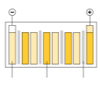




Batteries are a crucial part and key challenge for EVs, but thanks to early efforts in solid-
state batteries and successful partnerships GM is already very well positioned
ALTERNATIVE SOLUTION – R&D OPPORTUNITY
New battery technology is needed GM is a leading player and early mover in battery technology…
Lithium-ion batteries
Hit limit of storage capacity and charging speed
Not capable of travelling 500 miles on a single charge
Solid-state batteries
Cheaper and safer
Capable of travelling 500 miles on a single charge and allow faster charging
Patent filings related to solid-state EV batteries
233
GM invested $3.2m in Sakti3 already
in 2010 as one of the first movers
79
56
53
29
28
26 25
Nissan Radlok
23
15
Toyota
Semi- Integrated conductor Power
Solutions
Sakti3
Hyundai
Bosch
Quantum- Murata Scape
… and is maintaining very successful partnerships
Battery production is very competitive
Battery technology
Charging systems
Batteries are increasingly becoming the leading power source for mobility
Battery manufacturers are expanding production capacity significantly to capture market share and economies of scale
However, BCG expects that battery cell production will exceed demand by 40% in 2021, which will lead to tremendous price pressure
Cost per kWh
-31.0%
Miles per minute of charge₁₈
GM develops, LG Chem produces and Honda sources the batteries
Higher storage capacity and faster charging
Development of solid-state fast charging system
GM expects to have vehicle fleet ready with it by 2023
145
100
12
6
2018 2021e
Source: Welch (2018a, Bloomberg), Lienert, P. and White, J. (2018, Thomson Reuters), Greenwood (2018, Engineering.com), Stringer, D. and Buckland, K. (2019, Bloomberg), Motavalli (2010,
New York Times), Lambert (2018c, Electrek), BCG (2018c)
Appendix

Slide 75
Table of contents
I. | Referenced deep dives Strategic fit Financial analysis Feasibility Alternative solution | p. 67
II. | Additional insights Market analysis Strategic fit | p. 76
Appendix

Slide 76
MARKET ANALYSIS
Globally, as well as in the US, the plug-in sales mix has been pushed towards BEVs
Globally, the plug-in sales mix has been pushed towards BEVs
Plug-in sales mix globally, 2012 – 2018
In the US, the mix has been pushed towards BEVs as well
Plug-in sales mix in the US, 2016 – 2018
100%
100%
90%
90%
27%
28%
80%
41%
36%
38%
80%
52%
45%
47%
46%
47%
46%
46%
70%
55%
70%
60%
60%
In all of 2018, BEVs
represented 66% of total
50%
50%
plug-in sales, which to
a large degree is due
40%
40%
to the high level of
Tesla’s Model 3 sales
73%
72%
30%
59%
64%
62%
30%
55%
53%
54% 54%
54%
45%
48%
53%
20%
20%
10%
10%
0%
2012 2013
Plug-In Hybrids
2014 2015 2016
Battery Electric Vehicles
0%
2016 2017
Plug-In Hybrids
Q1-2018 Q2-2018 Q3-2018 Q4-2018
Battery Electric Vehicles
2017
2018
Source: Irle, R. (2018, EVVolumes)
Appendix

Slide 77
Americans bought over 17 million vehicles in 2018, 68 percent of which were pickup
trucks and SUVs, continuing a years-long trend away from cars
MARKET ANALYSIS
The best-selling cars in the US are mostly pickup trucks and SUVs
Top 10 best-selling cars in # of vehicles sold in the US, 2018
Ford F-series
Chevrolet Silverado
Dodge Ram Toyota Rav4
Nissan Rogue/Rogue Sport
909,330
585,581
536,980
427,170
412,110
Honda CR-V
Toyota Camry Chevrolet Equinox
Honda Civic
Toyota Corolla
397,013
343,439
332,618
325,760
303,732
Sedans
Pickup trucks
SUVs
Source: Capparella, J. (2019, Car and Driver), Focus2Move (2019), Gastelu, G. (2019, Fox News)
Appendix

Slide 78
MARKET ANALYSIS
China is in a leading position in the field of e-mobility
China is in a leading position in the field of e-mobility
Leading countries, Roland Berger’s E-mobility Index 2018
China
0.9
5.0
5.0
10.9
The U.S.
1.8
4.6
4.5
10.9
Japan
1.8
4.3
4.2
10.3
Germany
2.2
3.0
5.0
10.2
South Korea
2.1
3.8
3.1
9.0
France
2.9
1.5
5.0
9.4
Technology Industry
Source: Roland Berger’s E-mobility Index 2018
Market
Appendix
| 78

Slide 79

MARKET ANALYSIS
An overview of car markets and the EV segment in various regions from 2012 – 2017
Global car registration and sales by region
EUROPE – EV segment
CHINA – EV segment
USA – EV segment
Market share: 1%
CAGR₁₂₋₁₇: +59%
300
200
100
Market share: 2%
CAGR₁₂₋₁₇: +126%
800
600
Market share: 1%
CAGR₁₂₋₁₇: +30%
300
200
Thousands
Thousands
Thousands
+50%
400
200
0
+117%
+48%
+19%
0
+72%
+236%
100
0
201220132014201520162017
201220132014201520162017
201220132014201520162017
29.1m
+8.6%
17.6m
+3.5%
20.9m
+2.3%
OTHER AMERICAS – EV segment
Market share: less than 1%
CAGR₁₂₋₁₇: +51%
20
REST OF WORLD – EV segment
Market share: less than 1%
CAGR₁₂₋₁₇: +32%
150
8.2m
-1.6%
Thousands
15
10
5
0
20.9m
+0.5%
+66%
LEGEND
Thousands
+41%
2017
Sales
^{CAGR}12-17
100
50
0
+26%
2012 2013 2014 2015 2016 2017
BEV
PHEV
Source: OICA (2019), IEA (2019)
+41%
201220132014201520162017
Appendix

Slide 80

Car manufacturers need to find new sources of profits as their core business is doomed
to sluggish revenue growth and more heated competition coming from consolidation
MARKET ANALYSIS
The growth sales of passenger cars and commercial vehicles is sluggish…
…while the industry consolidates, leading to more heated competition…
… which has put profits on a downward trend since 2013
Operating margin of 2016 top 10
players (2012-2016)¹⁾
Global car & vehicles registration and sales
(2012-2017) [Mio. Units and %]
Global automotive M&A deal volume and
value (2012-2017)
Volume [Mio. Units] YoY growth [%]
5%
Deal volume [units] Disclosed deal value ($bn)
6,8%
140
120
100
80
60
40
20
0
6,1%
591
583
598
_{5,1%} 5,2% _{4,9%}
543
4,5%
490
465
3%
3%
53
2%
41
39
62
30
22
2013
2015
2017
2012 2013 2014 2015 2016 2017
2012 2013 2014 2015 2016 2017
Source: OICA (2019), Xerfi (2017, pp. 16-46), Thomson One (2019)
Appendix

Slide 81















The automotive industry is currently converging to a software-driven industry where the
value chain is expanded to incorporate digital services, and hardware/software providers
MARKET ANALYSIS
From supply and manufacture of cars … … to mobility as a software-driven service
Traditional automotive industry
New ecosystem
2015 share of profits: 68%
2030 share of profits: 49%
2015 share of profits: 32%
2030 share of profits:
51%
Vehicle sales
Aftermarket
Financing
Hardware & software
Shared mobility
Representation of “Freedom”
Strategy focused on individuals’ parts quality, safety, performance and mass production
R&D focused on performance-oriented features, such as horsepower and gadgetry
Sold mostly for retail customers
Representation of “Efficiency”
Strategy focused on data gathering, integration of multiple technologies, connectivity and the larger mobility network
R&D focused on content requirements, emissions reduction and safety
Sold to fleets that provide mobility as a service
Source: Xerfi (2017), PwC (2017a)
Appendix

Slide 82

Becoming a key player in the BEV market will become a necessity for automakers in 10
years, based on increasing regulatory pressure and customer preferences
MARKET ANALYSIS
Very attractive prospects for BEVs worldwide Decreasing CO₂ emission targets
EU China
Fuel economy regulations in major markets
Financial incentives, such as subsidies, VAT and vehicle registration tax exemptions
City access restrictions in 20 major cities worldwide
Number of BEVs in use worldwide [in ’000]
125.000
170
CAGR ’15-’30
Engine Electric
130
90
70
-2.4%
41%
13.000
2015 2025
Resolved customer expectations
Driving range constantly improving: Several EVs models have a 250-mile-plus range, with 95% of car journeys are under 25 miles
Costs are coming down: Increase in grants and break- even point turning lower, as operating an EV currently at a cost of 2 cents per mile
Increased public charging points for EVs: As there are
currently 16,000 charging points and 340 added monthly
1.186
1.928
727
2015 2016 2017 …
Source: McKinsey & Company (2018), Deloitte (2018)
2020
…
2030
Appendix

Slide 83






The ADAS market is exponentially growing giving rise to new players and disrupting
traditional industries such as mobility, logistics, insurance or entertainment
MARKET ANALYSIS
The growing autonomous market is giving birth to new players that don’t regularly play in the automotive industry…
… and shifting the profit pools towards providers of ADAS technology, software and digital services
Top 5 players
(2018) by market
ADAS¹ OEMs²
Fully and semi-autonomous volume of cars [in Mn]
Scenario for profit shifts in the automotive industry, 2015–2030 [%]³
17,8
1%
1%
5%
Digital services
Supplier (new technology/software)
1
2%
New players
14%
11%
2
12,7
14%
20%
Shared mobility
11%
4%
Supplier (traditional/hardware))
Insurance
3
11%
8,4
16%
10%
Financing
4
5,0
10%
Aftermarket
3,1
41%
1,8
29%
Vehicle sales
5
0,5
1,0
0,3
Non-automakers
2017 2018 2019 2020 2021 2022 2023 2024 2025
2015 2030e
Note: 1. By average number of miles driven in autonomous mode without human intervention in 2018; 2. By revenues; 3. Based on a PwC scenario with a non-consolidated view: supplier value pools not eliminated from vehicle/ aftermarket revenues to show full industry value pools
Source: Backman (2016, Atlas), PwC (2017a)
Appendix

Slide 84
Because of carsharing and changing customers’ behaviors, the expected increase in
private vehicle-sales will be dampened worldwide
MARKET ANALYSIS
Global carsharing growth worldwide (2006-2014)
Annual global vehicle sales (millions of units)*
Users [Mio.]
104.125
Shared vehicles [Mio.]
23
4.843
41
10
115
43.554
87
19.403
31.967
1.788
11.501
671
1.164
347
2006 2008 2010 2012
Willingness to trade in own car and use a robo-taxi in % of
respondents (2018)
2014
47%
39%
46%
70%
19%
56%
58%
100%
64%
44%
50%
2015
private vehicles
CAGR
3.6
Urbanization and macro- economic growth
Fewer private vehicles
New share vehicles
2030
private vehicles
45%
41%
3%
35%
8%
11%
9%
29%
1%
17%
7%
Total 18-29
30-64
By age
65-75 China
Germany
By country
U.S.
1.9-2.4
2015-2030
No, I would want to keep my car Yes, if the cost is lower or equal
Yes, I would be willing to pay a premium
2010-2015
*in high disruption scenarios, McKinsey Shared Mobility Report
Source: Goodall, W., Dovey Fishman, T., Bornstein, J. and Bonthron, B. (2017, Deloitte Review), Grosse-Ophoff, A., Hausler, S., Heineke, K., and Möller, T. (2017, McKinsey)
Appendix

Slide 85
Individuals are likely to switch from manufacturers or pay a premium to have the right
applications and media on the car – which gives rise to new business models
MARKET ANALYSIS
Preferences of individuals regarding connectivity services [% of respondents answering “yes”]
New business models arising by providers and customer segments
Customer segments
I would switch to another manufacturer if it was the only one offering a car with full access to applications, data and media
37%
I would be willing to pay for connected services in my car in a subscription based model
Providers Drivers/ of… passengers
Governments/ municipalities
Dealers/ aftersales
Cars | Connected navigation (real-time traffic, weather, road conditions) |  |  | Consolidated vehicle data- based road maintenance (deicing, snow clearance) | Diagnostic and ordering (remote checkups)
 | Remote preventing diagnostics and maintenance based on car/fleet data
Content/ Services | For drivers: Phone, office, e- mail | For passengers: Internet, social media, video games |  | Traffic management and V2I communication (usage-based tolling, adaptive traffic control) | Data-driven connected marketplace for repair/mainte nance
 | Content feed by linear providers (cable networks) and dynamic streaming services (Spotify, Netflix)
Mobility | Personalized dynamic car pooling |  | Taxi/e-hailing/ride- sharing | Enhancement of public transport with car sharing fleet
Infra. | SIM cards and LTE sites along highways to enable broadband traffic |  |  | Networked parking
32%
+85%
+52%
21%
20%
2014 2015 2014 2015
Both willingness to switch manufacturer and to pay a subscription fee for connected car services has increased significantly year after year
McKinsey Connectivity and Autonomous Driving Consumer Survey 2014 and 2015
Insurance
Personalized insurance policies based
on driving behavior/pattern analysis
Further extensions possible
McKinsey (2018)
Appendix

Slide 86






All major OEMs are already making big bets in carsharing, AV and EV technology, and car
connectivity, to stay relevant when this future arrives
MARKET ANALYSIS
Initiatives taken by the 2018 Top 5 car manufacturers, for EVs, AVs, car sharing and connectivity
Electric
^{vehicles} Announced investment of
JV with JAC to mass-market Collaboration with Mazda on 12 new BEVs announced to Hyundai’s Kona EV to be on _{$11bn in EVs by 2022}
electric cars in China (2016) electric vehicles (2017) be available by 2022 (2018) sale in the US early 2019 ₍₂₀₁₉₎
Autonomous vehicles
Collaboration with Ford to develop autonomous vehicles (2019)
Autonomous prototype based on a Lexus model (2019)
ProPilot driver assist system available on Nissan Leaf and Infiniti Q50 sedan (2017)
Hyundai and Aurora will develop level 4 autonomous vehicles by 2021 (2018)
Acquisition of Argo AI to add to Ford’s self-driving technology (2017)
Carsharing
“We Share” offering in selected major cities (service to begin in 2019)
Yuko car-sharing services in Europe, to be launched in 2019
Carsharing service launched by Renault (Moov’in Paris)
Tested carsharing system with 100 fully electric Ioniqs in Amsterdam (2017)
Ford Credit Link: group- lease of Ford vehicles (2016)
Connectivity
Integration of Siri in the car Addition of Android Auto and Microsoft teams up with Hyundai Tucson integrating connectivity VW Car-Net Apple CarPlay to Toyota’s Renault-Nissan on in-car connectivity features (Apple
mobile app trucks and SUVs (2019) productivity and connectivity CarPlay, Android Auto)
Partnership with Vodafone on 4G LTE connectivity with the FordPass Connect modem (2017)
Source: Xerfi (2017)
Appendix

Slide 87
STRATEGIC FIT – TESLA
Tesla trumps Audi and Jaguar EVs in independent efficiency test
Audi and Jaguar consume a quarter more energy than Tesla
Consumption KWH/100 KM at average speed of 120 KM/H
Tesla also takes the lead with regards to range
Range in KM at average speed of 120 KM/H
Technology
Tesla Model X 90D
24.8
Tesla Model X 90D
339.0
+23%
-19%
Audi E-Tron
30.5
Audi E-Tron
274.0
+3%
-1%
Jaguar I-Pace
31.3
Jaguar I-Pace
272.0
0.00 5.00 10.00 15.00 20.00 25.00 30.00 35.00
0.00
100.00
200.00
300.00
400.00
Source: NextMove (2019)
Appendix

Slide 88
In the end of 2018, Tesla’s market capitalization overtook Daimler as the third most-
valuable automaker, but has now fallen back to a fourth place
STRATEGIC FIT – TESLA
Tesla is now the fourth most valuable automaker in the world
Market caps of the world’s most valuable car companies, 2019
Toyota Volkswagen Daimler | 80,32 57,380,000,000
Tesla Model 3 | 54,560,000,000
BMW | 49,370,000,000
Honda | 48,030,000,000
General Motors | 47,040,000,000
Nissan Altima | 33,770,000,000
Ford | 32,140,000,000
Fiat Chrysler | 26,460,000,000
190,460,000,000
0,000,000
Note: Stock values in USD, as of Jan. 6
Source: Bloomberg (2019)
Appendix

Slide 89
In the second half of 2018, Tesla became a “real car company” by breaking into America’s
top ten in terms of sedan sales
STRATEGIC FIT – TESLA
In the second half of 2018, Tesla broke into America’s top ten…
US sedan sales in number of cars sold in the second half of 2018
Toyota Camry Toyota Corolla Honda Accord Honda Civic
Tesla Model 3 | 119,000
Hyundai Elantra |  |  | 100,700
Nissan Sentra |  |  | 97,400
Ford Fusion |  | 86,600
Nissan Altima |  | 85,400
hevrolet Malibu | 68,100
164,600
153,900
152,800
149,500
C
Note: Tesla’s Model 3 tally includes some deliveries in Canada
Source: Bloomberg (2019), Tesla (2019a)
Appendix

Slide 90
STRATEGIC FIT – TESLA
Tesla has made net losses in every year that it has existed
Tesla has made net losses in every year that it has existed
Tesla’s net loss in million US dollars, FY 2008 to FY 2018
0
-200
-400
-600
-800
-1,000
-1,200
-1,400
-1,600
-1,800
-2,000
-2,200
-2,400
-83
-56
-154
-74
-254
-294
-396
-889
-773
-1,063
-2,241
2017
2008
2009
2010
2011
2012
2013
2014
2015
2016
2018
Source: Tesla (2011, 2015, 2016, 2017, 2018, 2019a)
Appendix

Slide 91
STRATEGIC FIT – TESLA
Tesla’s brand is the 8th most valuable globally in the automotive sector
Tesla is the 8th most valuable brand in the automotive sector
Most valuable global brands for carmakers in billion US dollars, 2018
Toyota
#1
29.99
Mercedes-Benz
#2
25.68
BMW
#3
25.62
Ford
#4
12.74
Honda
#5
12.70
Nissan
#6
11.43
Audi
#7
9.63
Tesla
#8
9.42
Tesla’s brand increased by 60% in value from 2017 to
Maruti Suzuki
#9
6.38
2018 – this makes Tesla #8 on the list for top risers as
Volkswagen
#10
5.99
well
Source: Kantar Millward Brown, the 2018 BrandZ™ Top 100 Most Valuable Global Brands ranking and report, Tesla; FY 2010 to FY 2018
Appendix

Slide 92
STRATEGIC FIT – TESLA
Tesla’s R&D development expenses have increased steadily
Tesla's research and development expenses has increased…
Tesla’s R&D expenses million US dollars, FY 2010 to FY 2018
1,500
1,400
1,300
1,200
1,100
1,000
900
800
700
600
500
400
300
200
100
0
1,460
1,378
834
718
465
274
232
209
93
2010
2011
2012
2013
2014
2015
2016
2017
2018
Source: Kantar Millward Brown, the 2018 BrandZ™ Top 100 Most Valuable Global Brands ranking and report, Tesla; FY 2010 to FY 2018
Appendix

Slide 93











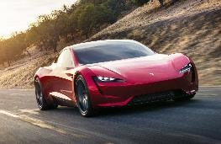

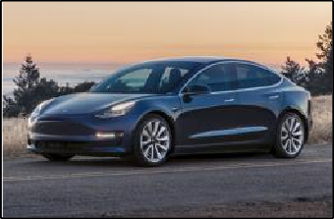

Tesla is currently addressing the main concerns regarding EVs and has been a key driver
in the rise of acceptance of EVs
STRATEGIC FIT – TESLA
Customer concerns regarding BEVs [% of respondents]
Tesla has created the following solutions:
1
31% | 31% | 35% | 4% | 26% | 25% | 14% | 18% | 10% | 24%
The upcoming Tesla Roadster (2020) is the BEV with the highest driving range
Range to keep progressing based on new components in batteries
Driving range
Tesla’s Next Gen
Roadster
2
Price premium
28% | 32% | 22% | 19% | 24% | 9% | 14% | 31% | 22% | 26%
Premium EV’s model 3 released at
$35,000 (with governmental subsidies), the cheapest premium BEV and 50% cheaper than the second cheapest Tesla model
Tesla’s Model 3
Tesla’s Roadster
3
Lack of charging infra- structure
20% | 16% | 20% | 44% | 22% | 18% | 25% | 23% | 34% | 25%
Tesla’s Supercharger infrastructure grew ten-fold from 119 in 2014 to 1,063 station in 2017
Tesla’s Supercharger
Source: Deloitte (2018)
xx
Largest concern in each market
Appendix
| 93

Slide 94

–
BIBLIOGRAPHY
What inspired us along
the way

Slide 95
Bibliography
Allied Market Research. (2017) Renewable Energy Market by type. Allied Market Research [online]. Available at: Subscription Service (Accessed: 9 February 2019)
Atlis Motor Vehicles. (2019) Company website. Atlis Motor Vehicles [online]. Available at: https://www.atlismotorvehicles.com/ (Accessed: 20 February 2019)
Backman, M. (2016) The 10 largest corporate bond deals of all time. Atlas [online]. Available at: https://www.theatlas.com/charts/NkxGaqJOx (Accessed: 26 February 2019) BAIC. (2018) Annual report 2017 [online]. Available at: http://www.baicmotor.com/Uploads/file/20180425/20180425182120_51593.pdf (Accessed: 15 February 2019) Barclays. (2019) Tesla Inc. Debat shifts to Model 3 run rate. Thomson Reuters, Barclays, 31 January [online]. Available at: Subscription Service (Accessed: 18 January 2019)
Barnard, M. (2018) Will Tesla Sales Plummet In 2019 With Loss Of Tax Credit & Backlog Filled? CleanTechnica, 23 December [online]. Available at: https://cleantechnica.com/2018/12/23/will-tesla- sales-plummet-in-2019-with-loss-of-tax-credit-backlog-filled/ (Accessed: 19 February 2019)
Bartlett, J. (2019) Car Brands Ranked by Owner Satisfaction. Consumer Reports, 5 February [online]. Available at: https://www.consumerreports.org/car-reliability-owner-satisfaction/car-brands- ranked-by-owner-satisfaction/ (Accessed: 13 February)
BCG. (2018a) Batteries for Electric Cars: Challenges, Opportunities, and the Outlook of 2020. BCG [online]. Available at: https://www.bcg.com/documents/file36615.pdf (Accessed: 20 February 2019)
BCG. (2018b) The Future of Battery Production for Electric Vehicles. BCG, 11 September [online]. Available at: https://www.bcg.com/publications/2018/future-battery-production-electric- vehicles.aspx (Accessed: 16 February 2019)
BCG. (2019) The 2018 M&A Report. BCG [online]. Available at: http://image-src.bcg.com/Images/BCG-Synergies-Take-Center-Stage-Sep-2018_tcm9-202243.pdf (Accessed: 17 February 2019)
Bloomberg (2017) Electric Vehicle Outlook 2017. Bloomberg [online]. Available at: https://data.bloomberglp.com/bnef/sites/14/2017/07/BNEF_EVO_2017_ExecutiveSummary.pdf (Accessed: 25 February)
Bloomberg (2018) Electric Vehicle Outlook 2018. Bloomberg [online]. Available at: https://bnef.turtl.co/story/evo2018?teaser=true (Accessed: 25 February) Bloomberg. (2019) Bloomberg Professional [Online]. Available at: Subscription Service
Bollinger Motors. (2019) Company website. Bollinger Motors [online]. Available at: https://www.bollingermotors.com/ (Accessed: 20 February 2019)
Bibliography

Slide 96
Bibliography
Boudette, N. (2018) Tesla Turns Back Rare Challenge From Shareholders. New York Times, 5 June [online]. Available at: https://www.nytimes.com/2018/06/05/business/tesla-once-a-wall-street- darling-faces-investor-challenge.html (Accessed: 27 February 2019)
Brinkman, R. (2019) Tesla Inc. See Negative Reaction After 4Q Free Cash Flow Impresses But Aspects of 2019 Outlook and CFO Departure Disappoint. Thomson Reuters, J.P. Morgan, 31
January [online]. Available at: Subscription Service (Accessed: 13 February 2019)
Businesswise. (2019) Businesswise [online]. Available at: https://www.businesswise.com/ (Accessed: 19 February 2019)
BYD. (2018) Annual report 2017 [online]. Available at: http://www3.hkexnews.hk/listedco/listconews/sehk/2018/0327/ltn201803271463.pdf (Accessed: 12 February 2019)
CA.GOV. (2019) Autonomous disengagement report. State of California, Department of Motor vehicles [online]. Available at: https://www.dmv.ca.gov/portal/dmv/detail/vr/autonomous/disengagement_report_2018 (Accessed: 10 February)
Campbell, P. (2018) Should you buy an electric car? Financial Times, 31 August [online]. Available at: https://www.ft.com/content/6940cbaa-a7b7-11e8-8ecf-a7ae1beff35b (Accessed: 10 February 2019)
Capparella, J. (2019) The Best-Selling Cars, Trucks, and SUVs of 2018. Car and Driver, 3 January [online]. Available at: https://www.caranddriver.com/news/g25558401/best-selling-cars-suv- trucks-2018/ (Accessed: 12 February 2019).
Car and Driver. (2019) The Best-Selling Luxury Cars and SUVs of 2018. Car and Driver [online]. Available at: https://www.caranddriver.com/news/g25741172/best-selling-luxury-cars-suv-2018/ (Accessed: 26 February 2019)
CarSalesBase. (2019) US Car Sales Data. CarSalesBase [online]. Available at: http://carsalesbase.com/us-car-sales-data/ (Accessed: 26 February 2019)
Changan. (2018) Brand new EV model EADO EV460 Launches in Beijing. Changan website, 24 October [online]. Available at: http://www.globalchangan.com/article/news_content_395.html (Accessed: 26 February)
Charlton, A. (2018) The best electric cars and hybrids from the LA Motor Show. Wired, 1 December [online]. Available at: https://www.wired.co.uk/article/best-electric-cars-at-la-motor-show (Accessed: 21 February 2019)
CNBC. (2019) GM's Cadillac is said to plan to introduce electric vehicle in fight against Tesla. CNBC website, 10 January [online]. Available at: https://www.cnbc.com/2019/01/11/gms-cadillac-is- said-to-plan-to-introduce-ev--in-fight-against-tesla.html (Accessed: 10 February 2019)
Bibliography

Slide 97
Bibliography
Cohen, A. (2018) GM Must Adapt Or Die: A Lesson For U.S. Automakers. Forbes, 30 November [online]. Available at: https://www.forbes.com/sites/arielcohen/2018/11/30/gm-must-adapt-or-die-a- lesson-for-u-s-automakers/#1eb3eb932c2d (Accessed: 25 February 2019)
Cooke, D. (2018) Automakers Rankings 2018. The Environmental Performance of Car Companies. Union of Concerned Scientists [online].
https://www.ucsusa.org/sites/default/files/attach/2018/06/cv-automaker-rankings-2018-report.pdf (Accessed: 10 February 2019)
Cox Automotive. (2017) EV Consumer study. EIA Energy Conference, 27 June [online]. Available at: https://www.eia.gov/conference/2017/pdf/presentations/rebecca_lindland.pdf (Accessed: 16 February 2019)
Customer Guru. (2019) General Motors net promoter score 2019 benchmarks. Customer Guru [online]. Available at: https://customer.guru/net-promoter-score/general-motors (Accessed: 26 February 2019)
Dhawan, R., Hensley, R., Padhi, A. and Tschiesner, A. (2019) Mobility’s second great inflection point. McKinsey Quarterly [online]. Available at: https://www.mckinsey.com/industries/automotive- and-assembly/our-insights/mobilitys-second-great-inflection-point (Accessed: 28 February 2019)
DOJ. (2019) Department of Justice [online]. Available at: https://www.justice.gov/ (Accessed: 13 February 2019)
Edelstein, S. (2018) GM to Expand Michigan Battery Lab Ahead of Electric Car Push. The Drive, 7 September [online]. Available at: http://thedrive.com/tech/23424/gm-to-expand-michigan-battery- lab-ahead-of-electric-car-push (Accessed: 13 February 2019)
Eisenstein, P. (2018) Luxury car owners trade up for American pickups as Ford, GM and Ram trucks dominate market. CNBC, 5 November [online]. Available at: https://www.cnbc.com/2018/11/03/luxury-car-owners-trade-up-for-us-pickups-as-ford-gm-dominate-market.html (Accessed: 22 February 2019)
Eisenstein, P. (2019) General Motors is looking at building an all-electric line of GMC SUVs, Sierra pickup trucks. CNBC, 24 January [online]. Available at: https://www.cnbc.com/2019/01/23/pickups-ready-to-plug-in.html (Accessed: 26 February 2019)
Euromonitor. (2016) Evolution of Cost Drivers in the Auto Industry. Euromonitor [online]. Available at: https://blog.euromonitor.com/evolution-cost-drivers-auto-industry/ (Accessed: 20 February 2019)
FactSet. (2019) US M&A News and Trends. FactSet Flaswhire US monthly [online]. Available at: https://www.factset.com/hubfs/mergerstat_em/monthly/US-Flashwire-Monthly.pdf (Accessed: 25 February 2019)
Ferris, R. (2018) The steadily disappearing American car. CNBC, 7 April [online]. Available at: https://www.cnbc.com/2018/04/06/the-steadily-disappearing-american-car.html (Accessed: 23 February 2019)
Bibliography

Slide 98
Bibliography
Ferris, R. (2019) GM is going 'all-electric,' but it doesn't expect to make money off battery-powered cars until early next decade. CNBC, 6 February [online]. Available at: https://www.cnbc.com/2019/02/06/gm-doesnt-expect-to-make-money-off-electric-cars-until-next-decade.html (Accessed: 23 February 2019)
Ferris, R. and LeBeau, P. (2018) Elon Musk could make more than $50 billion from pay plan shareholders approved...but he has a lot to deliver. CNBC, 21 March [online]. Available at:
https://www.cnbc.com/2018/03/21/tesla-shareholders-approve-elon-musks-multibilion-dollar-compensation-plan.html (Accessed: 16 February 2019)
FTC. (2019) Federal Trade Commission [online]. Available at: https://www.ftc.gov/ (Accessed: 13 February 2019)
Gastelu, G. (2019) The 10 best-selling vehicles in the United States in 2018 were mostly trucks and SUVs. FoxNews, 4 January [online]. Available at: https://www.foxnews.com/auto/the-10-best- selling-vehicles-in-the-united-states-in-2018-were-mostly-trucks-and-suvs (Accessed: 15 February 2019)
Geely. (2018) Annual report 2017 [online]. Available at: http://www.geelyauto.com.hk/core/files/financial/en/2017-02.pdf (Accessed: 14 February 2019)
General Motors. (2016) Annual report 2015 [online]. Available at: http://www.annualreports.com/HostedData/AnnualReportArchive/g/NYSE_GM_2015.pdf (Accessed: 24 February 2019)
General Motors. (2018a) Annual report 2017 [online]. Available at: http://www.annualreports.com/HostedData/AnnualReports/PDF/NYSE_GM_2017.pdf (Accessed: 24 February 2019)
General Motors. (2018b) General Motors Accelerates Transformation. General Motors, 26 November [online]. Available at: https://media.gm.com/media/us/en/gm/news.detail.html/content/Pages/news/us/en/2018/nov/1126-gm.html (Accessed at: 26 February 2019))
General Motors. (2019a) General motors strengthens core business and future mobility. General Motors [online]. Available at: https://media.gm.com/content/dam/Media/gmcom/investor/2019/jan/Press-Release-1-11-19.pdf (Accessed: 26 February 2019)
General Motors. (2019b) Annual report 2018 [online]. Available at: https://investor.gm.com/static-files/cbb78eee-fd3b-47bc-93c8-2c73c4800042 (Accessed: 24 February 2019)
General Motors. (2019c) GM’s U.S. Crossover Sales Topped 1 million in 2018. General Motors, 3 January [online]. Available at: https://media.gm.com/media/us/en/gm/home.detail.html/content/Pages/news/us/en/2019/jan/0103-gmsales.html (Accessed: 1 March 2019)
Gessner, K. (2018) Tesla faces accelerating rate of Model 2 refunds. Second measure, 4 June [online]. Available at: https://secondmeasure.com/datapoints/tesla-faces-accelerating-rate-of-model-3- refunds/ (Accessed: 14 February 2019)
Gibbs, S. (2018) Tesla finally hits weekly production target for Model 3 cars. Guardian, 2 July [online]. Available at: https://www.theguardian.com/technology/2018/jul/02/tesla-finally-hits-weekly- production-target-for-model-3-cars (Accessed: 27 February 2019)
Bibliography

Slide 99
Bibliography
GM Authority. (2019a) Chevrolet Bolt EV Sales Numbers. GM Authority [online]. Available at: http://gmauthority.com/blog/gm/chevrolet/chevrolet-bolt-ev/chevrolet-bolt-ev-sales-numbers/ (Accessed; 24 February 2019)
GM Authority. (2019b) Chevrolet Volt Sales Numbers. GM Authority [online]. Available at: http://gmauthority.com/blog/gm/chevrolet/volt/chevrolet-volt-sales-numbers/ (Accessed; 24 February 2019)
Goldman, D. (2018) GM is reinventing itself. It's cutting 15% of its salaried workers and shutting 5 plants in North America. CNN Business, 26 November [online]. Available at: https://edition.cnn.com/2018/11/26/business/gm-oshawa-plant/index.html (Accessed: 12 February)
Goodall, W., Dovey Fishman, T., Bornstein, J. and Bonthron, B. (2017) The rise of mobility as a service. Deloitte Review [online]. Available at: https://www2.deloitte.com/content/dam/Deloitte/nl/Documents/consumer-business/deloitte-nl-cb-ths-rise-of-mobility-as-a-service.pdf (Accessed: 10 February 2019)
Grand View Research. (2018) ADAS market report. Market Research Reports [online]. Available at: Subscription Service (Accessed: 10 February 2019)
Greenwood, M. (2018) Honda and GM Partnering on Next Gen Battery. Engineering.com, 27 June [online]. Available at: https://www.engineering.com/AdvancedManufacturing/ArticleID/17078/Honda-and-GM-Partnering-on-Next-Gen-Battery.aspx (Accessed: 13 February 2019)
Grosse-Ophoff, A., Hausler, S., Heineke, K., and Möller, T. (2017) How shared mobility will change the automotive industry. McKinsey [online]. Available at: https://www.mckinsey.com/industries/automotive-and-assembly/our-insights/how-shared-mobility-will-change-the-automotive-industry (Accessed: 11 February 2019)
Hancock, T. (2019) Carmakers face cuts and gloom as China sales shift into reverse. Financial Times, 16 January [online]. Available at: https://www.ft.com/content/bcb902e4-1895-11e9-9e64- d150b3105d21 (Accessed: 10 February)
Harper, G. (2014) The role of business model innovation in transitioning ULEVs to market (Doctoral dissertation, Cardiff University)
Henke, J. (2017) 17th Annual North American Automotive OEM – Tier 1 Supplier Working Relations Index Study. Planning Perspectives Inc., 16 May [online]. Available at: https://societyofautomotiveanalysts.wildapricot.org/resources/Documents/SAA%20-Presentation-5-16-17_Henke.pdf (Accessed: 9 February 2019)
Hershorn, G. (2018) Merger & Acquisition Review. Full Year 2017. Thomson Reuters [online]. Available at: https://www.thomsonreuters.co.jp/content/dam/openweb/documents/pdf/japan/market- review/2017/ma-4q-2017-e.pdf (Accessed: 13 February 2019)
Hevi, X. (2017) Inauguration speech. New Energy Vehicle Technology Innovation Centre, Beijing, 4 September [online]. Available at: http://sse.cuhk.edu.cn/en/news/3848 (Accessed: 15 February 2018)
Bibliography

Slide 100

Bibliography
Holland-Letz, D., Kässer, M., Müller, T. and Tschiesner, A. (2018) Profiling tomorrow’s trendsetting car buyers. McKinsey & Company [online]. Available at: https://www.mckinsey.com/industries/automotive-and-assembly/our-insights/profiling-tomorrows-trendsetting-car-buyers (Accessed: 10 February 2019)
Houchois, P. (2018) Tesla Inc. Playing a positive sum game - Upgrade to Buy from Hold. Thomson Reuters, Jefferies, 7 December [online]. Available at: Subscription Service (Accessed: 10
February 2019)
IEA. (2019) Global EV Outlook 2018. IEA Website [online]. Available at: https://www.iea.org/gevo2018/ (Accessed: 24 February 2019) InsideEVs. (2019a) Compare Plug-ins. InsideEVs [online]. Available at: https://insideevs.com/compare-plug-ins/ (Accessed: 23 February 2019)
InsideEVs. (2019b) GM’s Electric Future – 300 Miles Of Range, Desirable And Affordable. InsideEVs [online]. Available at: https://insideevs.com/gm-electric-future-300-miles-range-desirable- affordable/ (Accessed: 11 February 2019)
InsideEVs. (2019c) Monthly plug-in EV sales scorecard: Historical charts. InsideEVs [online]. Available at: https://insideevs.com/monthly-plug-in-ev-sales-scorecard-historical-charts/ (Accessed: 15 February 2019)
InsideEVs. (2019d) China Electric Car Sales Soar To Almost 160,000 In December. InsideEVs, 15 January [online]. Available at: https://insideevs.com/china-electric-car-sales-december/ (Accessed: 16 February 2019)
Irle, R. (2018) Global Plug-in Sales for the 1st Half of 2018. EVVolumes [online]. Available at: http://www.ev-volumes.com/country/total-world-plug-in-vehicle-volumes/ (Accessed: 10 February 2019) Jonas, A. (2019) Tesla Inc. Can Tesla be self-financing in 2019? Thomson Reuters, Morgan Stanley, 5 February [online]. Available at: Subscription Service (Accessed: 10 February 2019)
Justia. (2019) Justia [online]. Available at: https://patents.justia.com/ (Accessed: 15 February 2019)
Kandi Technologies. (2018) Annual report 2017 [online]. Available at: https://www.sec.gov/Archives/edgar/data/1316517/000106299316008324/form10k.htm (Accessed: 17 February 2019)
Kantar MillwardBrown. (2018) Brandz Top 100 Most Valuable Global Brands 2018. Kantar MillwardBrown [online]. Available at: http://brandz.com/admin/uploads/files/BZ_Global_2018_DL.pdf (Accessed: 23 February 2019)
Korus, S. (2016) The automotive industry is on the threshold of massive consolidation. Ark Invest, 26 August [online]. Available at: https://ark-invest.com/research/automotive-consolidation (Accessed: 11 February 2019)
Bibliography

Slide 101
Bibliography
Lambert, F. (2018a) Tesla Model 3 reservations keep growing but 23% were refunded, report says. Electrek, 4 June [online]. Available at: https://electrek.co/2018/06/04/tesla-model-3-reservations- refunded-report/ (Accessed: 19 February 2019)
Lambert, F. (2018b) Tesla’s Gigafactory 1 battery cells have a 20% cost advantage over LG, new report says. Electrek, 20 November [online]. Available at: https://electrek.co/2018/11/20/tesla-
gigafactory-battery-cells-made-cost-advantage-panasonic-lg-report/ (Accessed: 13 February 2019)
Lambert, F. (2018c) Volkswagen becomes latest automaker to invest in solid-state batteries for electric cars. Electrek, 22 June [online]. Available at: https://electrek.co/2018/06/22/volkswagen- invest-solid-states-batteries-electric-cars/ (Accessed: 16 February 2019)
Lambert, F. (2018d) What to expect from Tesla in 2019: Model Y, Model S/X Refresh, and more. Electrek, 31 December [online]. Available at: https://electrek.co/2018/12/31/tesla-2019-model-y- model-s-x-refresh/ (Accessed: 37 February 2019)
Lambert, F. (2018e) GM and Honda are partnering to build next-generation batteries for electric vehicles. Electrek, 7 June [online]. Available at: https://electrek.co/2018/06/07/gm-honda-partner- next-gen-batteries-electric-vehicles/ (Accessed: 11 February 2019)
Lambert, F. (2018f) Closer look at Rivian’s R1T all-electric pickup truck and why I ordered it. Electrek, 29 November [online]. Available at: https://electrek.co/2018/11/29/rivian-r1t-electric-pickup- truck-order/ (Accessed: 11 February 2019)
Lambert, F. (2018g) A $52,000 plug-in electric pickup truck w/ range extender receives over 5,000 fleet orders, opens reservation to the public. Electrek, 9 January [online]. Available at: https://electrek.co/2018/01/09/workhorse-opens-reservation-electric-pickup-truck/ (Accessed: 13 February 2019)
Lambert, F. (2018h) Rivian unveils all-electric pickup truck with unbelievable specs. Electrek, 26 November [online]. Available at: https://electrek.co/2018/11/26/rivian-r1t-all-electric-pickup-specs/ (Accessed: 13 February 2019)
Lienert, P. and White, J. (2018) GM races to build a formula for profitable electric cars. Thomson Reuters, 9 January [online]. Available at: https://www.reuters.com/article/us-gm-electric-insight- idUSKBN1EY0GG (Accessed: 12 February 2019)
Loveday, E. (2019) Might there be a competitor for the Rivian R1T electric pickup truck? InsideEVs, 6 January [online]. Available at: https://insideevs.com/video-atlis-xt-electric-pickup-truck-500- mile-range/ (Accessed: 16 February 2019)
Loveday, S. (2018) In-Depth Look At Rivian’s History, Funding & Present. InsideEVs, 26 November [online]. Available at: https://insideevs.com/rivian-automotive-history-future/ (Accessed: 22 February 2019)
Bibliography

Slide 102
Bibliography
MacDonald, J. (2016) Electric vehicles to be 35% of global new car sales by 2040. Bloomberg, 25 February [online]. Available at: https://about.bnef.com/blog/electric-vehicles-to-be-35-of-global- new-car-sales-by-2040/ (Accessed: 28 February 2019)
MarketLine (2018). Company Profile: General Motors. MarketLine, 16 November [online]. Available at: Subscription Service (Accessed: 10 February 2019)
Maynard, M. (2015) 4 Differences Between Tesla And Other Carmakers. Forbes, 19 August [online]. Available at: https://www.forbes.com/sites/michelinemaynard/2015/08/19/4-differences- between-tesla-and-other-carmakers/ (Accessed: 17 February 2019)
McGee, P. (2018) Combustion engine car sales to hit peak demand in 2018, say analysts. Financial Times, 30 December [online] Available at: https://www.ft.com/content/62506c24-0aae-11e9- 9fe8-acdb36967cfc?sharetype=blocked (Accessed: 25 February 2019)
McKinsey & Company. (2017) Electrifying insights: How automakers can drive electrified vehicle sales and profitability. McKinsey & Company [online]. Available at: https://www.mckinsey.com/industries/automotive-and-assembly/our-insights/electrifying-insights-how-automakers-can-drive-electrified-vehicle-sales-and-profitability (Accessed: 26 February 2019)
MergerMarkets. (2019) MergerMarkets [online]. Available at: Subscription Service (Accessed: 13 February 2019)
Motavalli, J. (2010) G.M. Ventures Invests $3.2 Million in Battery Company. New York Times, 9 September [online]. Available at: https://wheels.blogs.nytimes.com/2010/09/09/g-m-ventures-invests- 3-2-million-in-battery-company/ (Accessed: 16 February 2019)
Musk, E. (2018) 16 September. Available at: https://twitter.com/elonmusk/status/1041500594467270656?lang=en (Accessed: 19 February 2019) Nasdaq. (2019) Nasdaq [online]. Available at: https://www.nasdaq.com/ (Accessed: 13 February 2019)
NVIDIA. (2019) Annual report 2018 [online]. Available at: https://s22.q4cdn.com/364334381/files/doc_financials/annual/2018/NVIDIA2018_AnnualReview-(new).pdf (Accessed: 20 February 2019)
O’Kane, S. (2018) Bollinger Motors teases a rugged electric pickup truck with 200 miles of range. Verge, 10 October [online]. Available at: https://www.theverge.com/2018/10/10/17961494/bollinger- motors-b2-electric-pickup-truck (Accessed: 16 February 2019)
OICA. (2019) International Organization of Motor Vehicle Manufacturers [online]. Available at: http://www.oica.net/ (Accessed: 12 February 2019)
Ouimet, P. (2012) What Motivates Minority Acquisitions? The Trade-Offs between a Partial Equity Stake and Complete Integration. EFA 2007 Ljubljana Meetings Paper, 20 October [online]. Available at http://dx.doi.org/10.2139/ssrn.966700 (Accessed: 12 February 2019)
Bibliography

Slide 103
Bibliography
Prenzler, C. (2018) Rivian announces “Half a Billion” in Funding, Including $200M in Debt from London-based Bank. AdaptBN, 23 May [online]. Available at: https://www.adaptbn.com/home/2018/5/23/rivian-announces-half-a-billion-in-funding-raising-200m-in-debt-from-london-based-bank (Accessed: 16 February 2019)
Pressman, M. (2018) Tesla’s Business Model More Similar To Amazon’s Than You Think. CleanTechnica, 30 June [online]. Available at: https://cleantechnica.com/2018/07/30/teslas-business-
model-more-similar-to-amazons-than-you-think/ (Accessed: 17 February 2019)
Pulliam, S., Ramsey, M. and Mullins, B. (2016), Elon Musk Supports His Business Empire With Unusual Financial Moves. The Wall Street Journal, 27 April [online]. Available at: https://www.wsj.com/articles/elon-musk-supports-his-business-empire-with-unusual-financial-moves-1461781962 (Accessed: 14 February 2019)
PwC. (2017a) Connected Car Report 2016. PwC [online]. Available at: https://www.strategyand.pwc.com/media/file/Connected-car-report-2016.pdf (Accessed: 9 February 2019)
PwC. (2017b) The 2017 Strategy & Digital Auto Report. PwC [online]. Available at: https://www.strategyand.pwc.com/media/file/2017-Strategyand-Digital-Auto-Report.pdf (Accessed: 11 February 2019)
Pyper, J. (2019) A Q&A with Rivian, the Amazon-Backed Electric Truck Startup. GTM, 20 February [online]. Available at: https://www.greentechmedia.com/articles/read/rivian-amazon-backed- electric-truck-startup#gs.6FUn46T8 (Accessed: 21 February 2019)
Randall, C. (2019) Atlis presents electric pickup with 800 km range. Electrive.com, 7 January [online]. Available at: https://www.electrive.com/2019/01/07/atlis-presents-electric-pickup-with-800-km- range/ (Accessed: 25 February 2019)
Randall, T. and Halford, D. (2019) Tesla Model 3 Tracker. Bloomberg, 27 February [online]. Available at: https://www.bloomberg.com/graphics/2018-tesla-tracker/ (Accessed: 27 February 2019)
Renaissance Capital. (2019) All Time Largest U.S. IPOs. Renaissance Capital [online]. Available at: https://www.renaissancecapital.com/IPO-Center/Stats/Largest-US-IPOs (Accessed: 25 February 2019)
Rivian. (2019) The world’s first Electric Adventure Vehicles. Rivian [online]. Available at: https://products.rivian.com/ (Accessed: 22 February 2019).
Seeking Alpha. (2018a) Cruise Valuation up to $15bn. Seeking Alpha, 3 October [online]. Available at: https://seekingalpha.com/news/3394743-cruise-valuation-15b (Accessed; 9 February 2019)
Seeking Alpha. (2018b) Tesla's Low 2019 Capex Could Harm Its Growth Story And Brand Value. Seeking Alpha, 25 February [online]. Available at: https://seekingalpha.com/article/4243835-teslas- low-2019-capex-harm-growth-story-brand-value?dr=1 (Accessed; 26 February 2019)
Seppala, J. (2018) Inside the automotive startup taking EVs off-road. Engadget, 21 May [online]. Available at: https://www.engadget.com/2018/05/21/rivian-ev-truck-suv-detroit/?guccounter=1 (Accessed: 23 February 2019)
Bibliography

Slide 104
Bibliography
Sheetz, M. (2019) Tesla's electric vehicle dominance is about to have 'serious competition,' Morgan Stanley says. CNBC, 11 February [online]. Available at: https://www.cnbc.com/2019/02/11/morgan-stanley-serious-tesla-electric-vehicle-competition-from-rivian.html (Accessed: 20 February 2019)
Smith, A. (2019) Silverado vs. Sierra. PonyParts, 13 February [online]. Available at: https://www.cjponyparts.com/resources/chevy-silverado-vs-gmc-sierra (Accessed: 15 February 2019)
Smith, B. (2018) The future of EVs: “greener pasture”. Experian, 2 November [online]. Available at: http://www.experian.com/blogs/insights/2018/11/future-evs-greener-pastures/ (Accessed: 12 February 2019)
Snyder, J. (2017) Crossovers and SUVs fatten profit margins. Automotive News, 24 July [online]. Available at: https://www.autonews.com/article/20170724/RETAIL01/170729911/crossovers-and- suvs-fatten-profit-margins (Accessed: 22 February 2019
Soule, M. (2019) Cadillac Shows Brand’s First Fully Electric EV. Cadillac website, 13 January [online]. Available at: https://media.cadillac.com/media/us/en/cadillac/news.detail.html/content/Pages/news/us/en/2019/jan/0114-cadillac-ev.html (Accessed: 12 February 2019)
Statista. (2019a) US light truck retail sales from 1980 to 2018. Statista [online]. Available at: Subscription Service (Accessed: 10 February 2019) Statista. (2019b) Car brands: General Motors. Statista [online]. Available at: Subscription Service (Accessed: 10 February 2019)
Statista. (2019c) Volume of the ten largest secondary equity offerings until June 2009. Statista [online]. Available at: Subscription Service (Accessed: 24 February 2019)
Statista. (2019d) Number of Tesla vehicles delivered worldwide from 3rd quarter 2015 to 4th quarter 2018. Statista [online]. Available at: Subscription Service (Accessed: 27 February 2019) Statista. (2019e) Tesla's revenue from FY 2008 to FY 2018. Statista [online]. Available at: Subscription Service (Accessed: 27 February 2019)
Stockreports+. (2019) Tesla Inc. Detailed Stock Report. Thomson Reuters, 14 February [online] Available at: Subscription Service (Accessed: 18 February 2019), pp. 3-5.
Stringer, D. and Buckland, K. (2019) Before the Electric car takes over, someone needs to reinvent the battery. Bloomberg, 6 January [online]. Available at: https://www.bloomberg.com/news/articles/2019-01-06/before-the-electric-car-takes-over-someone-needs-to-reinvent-the-battery (Accessed: 12 February 2019)
Tannert, C. (2019) Meet R.J. Scaringe, Founder Of Rivian Automotive—And Tesla’s Worst Nightmare. Forbes, 8 February [online]. Available at: https://www.forbes.com/sites/chucktannert/2019/02/08/meet-rj-scaringe-founder-of-rivian-automotiveand-teslas-worst-nightmare/#75b90e617113 (Accessed: 23 February 2019)
Tesla Inc. (2011) Annual Report 2010 [online]. Available at: http://www.annualreports.com/HostedData/AnnualReportArchive/t/NASDAQ_TSLA_2010.pdf (Accessed: 20 February)
Bibliography

Slide 105
Bibliography
Tesla Inc. (2015) Annual Report 2014 [online]. Available at: http://www.annualreports.com/HostedData/AnnualReportArchive/t/NASDAQ_TSLA_2014.pdf (Accessed: 20 February)
Tesla Inc. (2016) Annual Report 2015 [online]. Available at: http://www.annualreports.com/HostedData/AnnualReportArchive/t/NASDAQ_TSLA_2015.pdf (Accessed: 20 February)
Tesla Inc. (2017) Annual Report 2016 [online]. Available at: http://www.annualreports.com/HostedData/AnnualReportArchive/t/NASDAQ_TSLA_2016.pdf (Accessed: 20 February) Tesla Inc. (2018) Annual Report 2017 [online]. Available at: http://www.annualreports.com/HostedData/AnnualReports/PDF/NASDAQ_TSLA_2017.pdf (Accessed: 20 February) Tesla Inc. (2019a) Annual Report 2018 [online]. Available at: http://ir.tesla.com/static-files/15df7636-8cd8-4b18-989b-4badeeda806c (Accessed: 25 February)
Tesla Inc. (2019b). Company website. Tesla Inc. [online]. Available at: https://www.tesla.com/
The Economist. (2017) After electric cars, what more will it take for batteries to change the face of energy? The Economist, 12 August [online]. Available at: Subscription Service (Accessed: 25 February 2019)
Thomson One Banker. (2019) Thomson One Banker. Thomson Reuters [Online]. Available at: http://banker.thomsonib.com/ Thomson Reuters Eikon. (2019) Thomson Reuters Eikon. Thomson Reuters [Online]. Available at: Subscription Service
UCSUSA. (2017) Barriers to Renewable Energy Technologies. UCSUSA, 20 December [online]. Available at: https://www.ucsusa.org/clean-energy/renewable-energy/barriers-to-renewable-energy (Accessed: 20 February 2019)
Vlasic, B. (2017) In Pivotal Moments, Tesla Unveils Its First Mass-Market Sedan. New York Times, 29 July [online]. Available at: https://www.nytimes.com/2017/07/29/business/tesla-model-3-elon- musk.html (Accessed: 27 February)
Volvo. (2018) Annual report 2017 [online]. Available at: https://www.volvogroup.com/content/dam/volvo/volvo-group/markets/global/en-en/investors/reports-and-presentations/annual-reports/annual- and-sustainability-report-2017.pdf (Accessed: 15 February 2019), pp. 20-30.
Wayland, M. (2018) Unlike 2008, GM cutting jobs, plants proactively. Automotive News, 3 December [online]. Available at: https://www.autonews.com/article/20181203/OEM/181209962/unlike- 2008-gm-cutting-jobs-plants-proactively (Accessed: 27 February 2019)
Wedbush. (2019) Tesla Inc. Company report. Thomson Reuters, Wedbush, 11 February [online]. Available at: Subscription Service (Accessed: 19 January 2019)
Bibliography

Slide 106
Bibliography
Welch, D. (2017) GM Sees Path to Elusive EV Profits, 1 Million Sales a Year. Bloomberg, 15 November [online]. Available at: https://www.bloomberg.com/news/articles/2017-11-15/gm-forecasts-1- million-electric-car-sales-by-2026-as-costs-drop (Accessed: 12 February 2019)
Welch, D. (2018a) GM Races Tesla to Quicker Electric-Car Battery Recharging Times. Bloomberg, 30 August [online]. Available at: https://www.bloomberg.com/news/articles/2018-08-30/gm-races-
tesla-to-quicker-electric-car-battery-recharging-times (Accessed: 10 February 2019)
Welch, D. (2018b) GM Plans More than 14,000 Job Cuts, Seven Factory Closing. Bloomberg, 26 November [online]. Available at: https://www.bloomberg.com/news/articles/2018-11-26/gm-to-cut- 10-000-jobs-targets-5-factories-for-closing-next-year (Accessed: 12 February 2019)
Welch, D., Bergen, M. and Barinka, A. (2018) GM is exploring listing shares of cruise self-driving unit. Bloomberg, 15 June [online]. Available at: https://www.bloomberg.com/news/articles/2018-06- 15/gm-is-said-to-explore-listing-shares-of-cruise-self-driving-unit. (Accessed: 9 February 2019)
WorkHorse. (2019) Company website. WorkHorse [online]. Available at: https://www.bollingermotors.com/ (Accessed: 20 February 2019)
Xerfi. (2018) The Global Carmaking Industry: The Market, Xerfi Market Research. Available at: Subscription Service (Accessed: 10 February 2019)
Zhang, Y. and Hull, D. (2019) Elon Musk in China to Break Ground for First Tesla Factory Outside U.S. Bloomberg, 7 January [online]. Available at: https://www.bloomberg.com/hyperdrive (Accessed: 27 February 2019)
Zhang, Y., Naughton, K., Rauwald, C. and Sachgau, O. (2018) China is Leading the World to an Electric Car Future. Bloomberg, 14 November [online]. Available at: https://www.bloomberg.com/news/articles/2018-11-14/china-is-leading-the-world-to-an-electric-car-future (Accessed: 27 February 2019)
Bibliography

